Slide 1
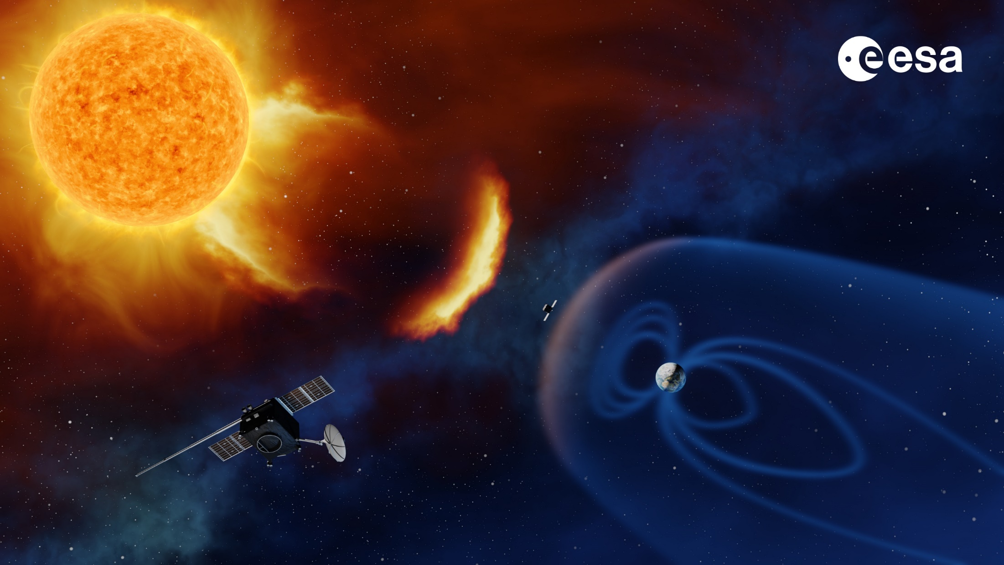
The Lagrange Mission
Jackie Davies, RAL Space
Remote-Sensing Package Consortium Lead

Slide 2
ESA SSA Programme
ESA’s SSA programme (currently) comprises four segments: NEO, SST, SWE and (since the start of P3 in 2017) LGR.
The LGR segment focusses on developing a pathway to the launch of a space weather monitoring mission to L5.
P2 SWE studies defined preliminary L5 mission objectives and assessed the required in-situ and remote-sensing payload.
Led to release of three P3 ITTs:
  L5 spacecraft (system) Phase A/B1 study
      Parallel activities (led by OHB and ADS)
  L5 RS package Phase A/B1 study + pre-developments
      Led by RAL Space
  L5 IS package Phase A/B1 study + pre-developments
      Led by MSSL

Slide 3
ESA SSA Programme
CURRENT STATUS:
Successful PRR (end of Phase A)
Phase B1 has been kicked off
PM3 (Progress Meeting 3 for all studies at end of January)
Several pre-developments are underway for the instrument studies
MISSION PROFILE:
5-year mission (10 year goal)
<2 year transfer time to L5
Launch May 2025
9 instrument payload (4 RS; 5 IS)

Slide 4
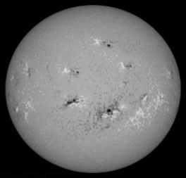
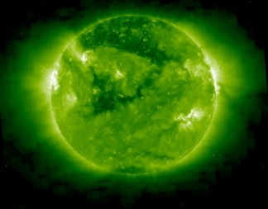
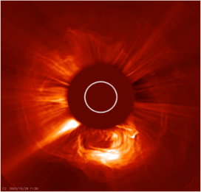
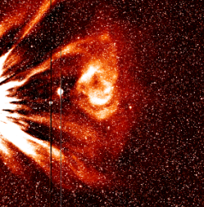
RS Package
  Four RS instruments:
    PMI (Photospheric Magnetic Field Imager)
    EUVI (Extreme Ultra-Violet Imager)
    COR (CORonagraph)
    HI (Heliospheric Imager)
  with a common* IPCU (Instrument Processing & Control Unit)
  *PMI has its own DHU that interfaces into the IPCU

Slide 5
Consortium Roles
Consortium Prime (RAL)
PMI : MPS, OHB
EUVI : CSL, ROB, PMOD
COR : RAL, UGOE
HI : RAL, UGOE
IPCU : ADS
G&F software architecture (E2ES) : Deimos-UK/Ro, RDA
Service provider → user requirements : UKMO

Slide 6
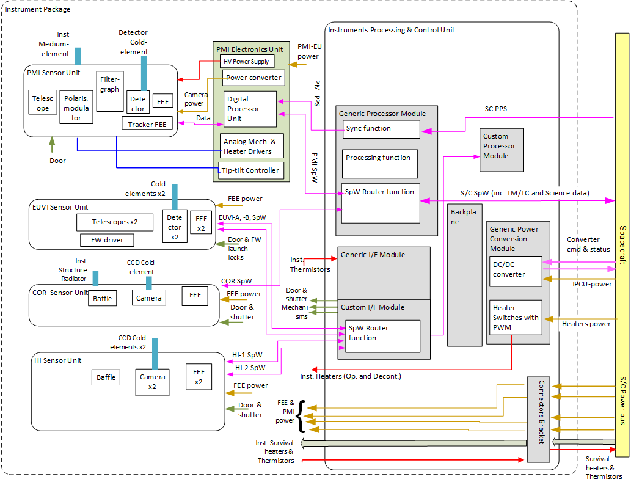
System block diagram
Detailed Block diagrams are in 5x unit-level DDs
  Including redundancy scheme

Slide 7
System block diagram
Currently, in both spacecraft designs, all instruments are externally mounted
Detailed Block diagrams are in 5x unit-level DDs
  Including redundancy scheme

Slide 8
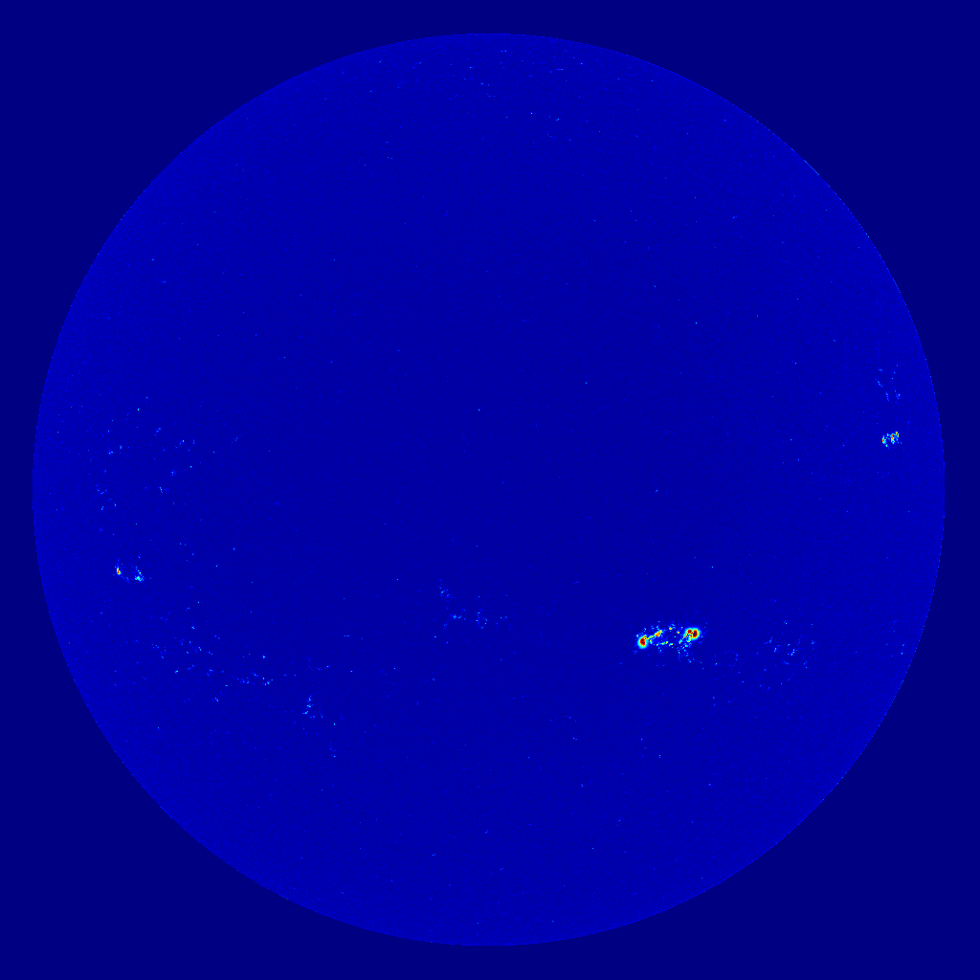
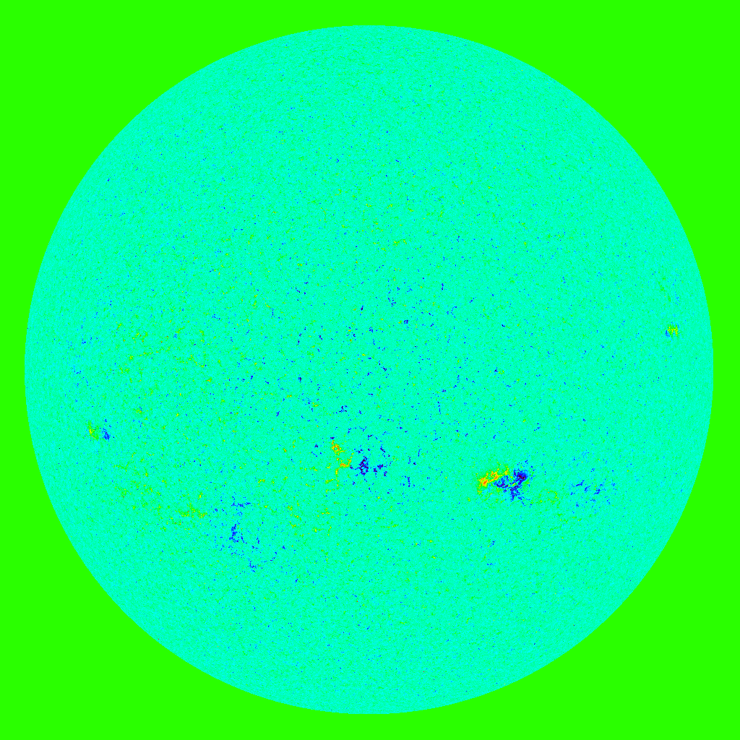
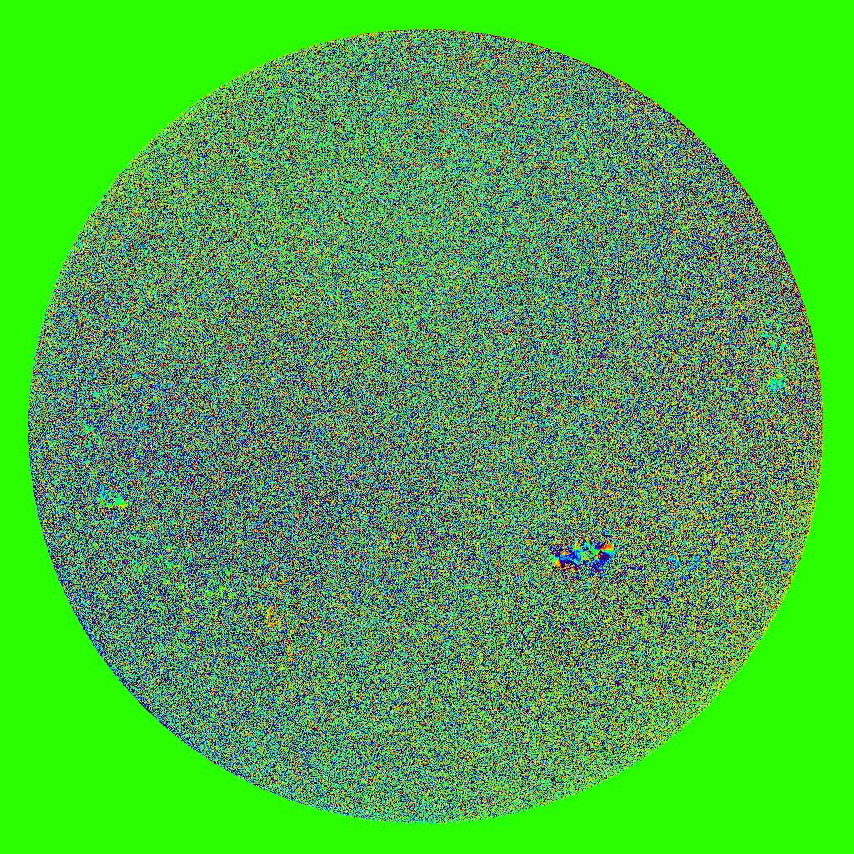
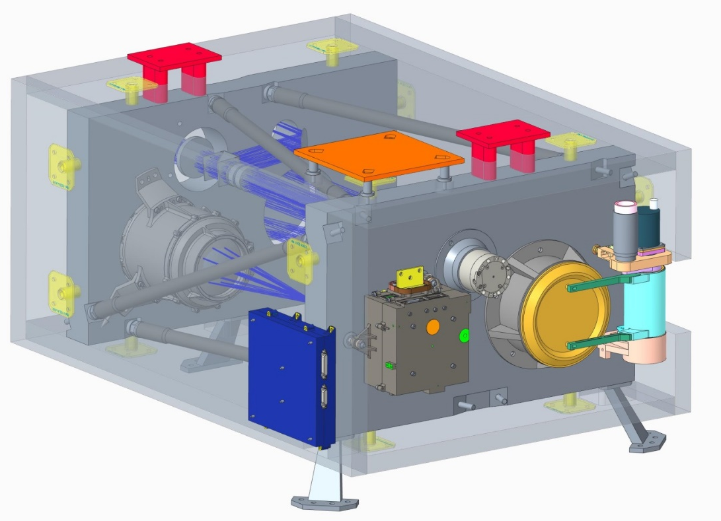
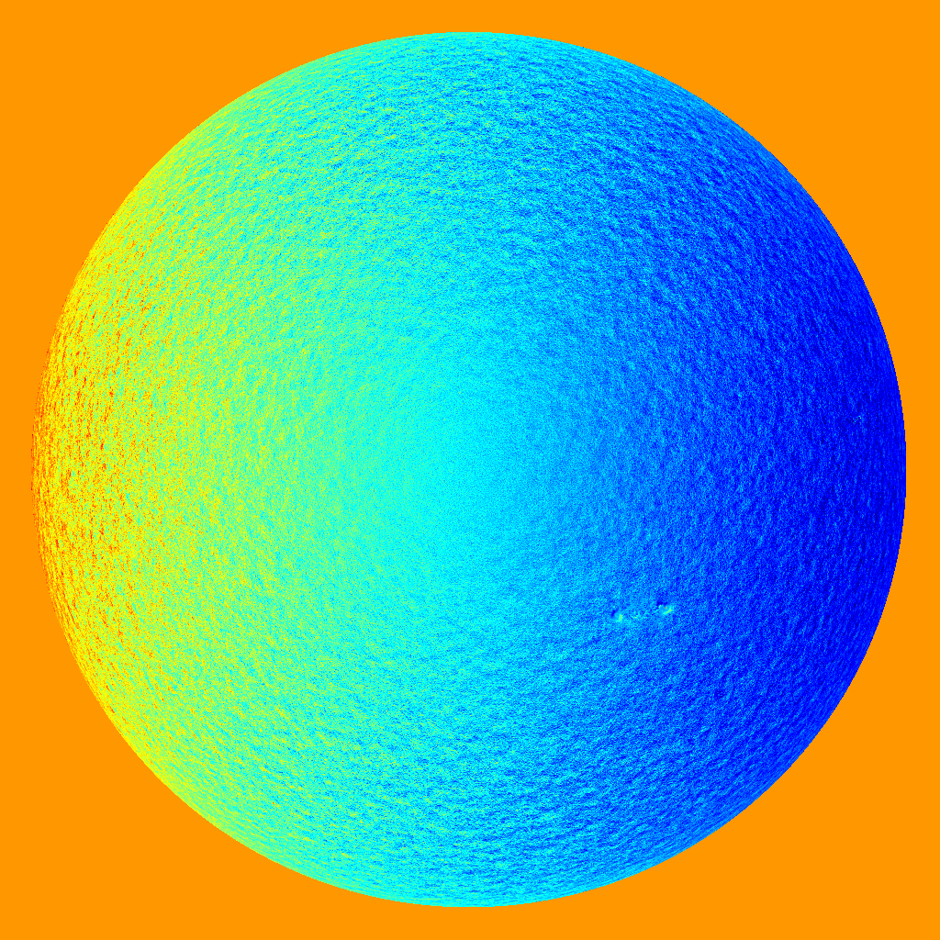
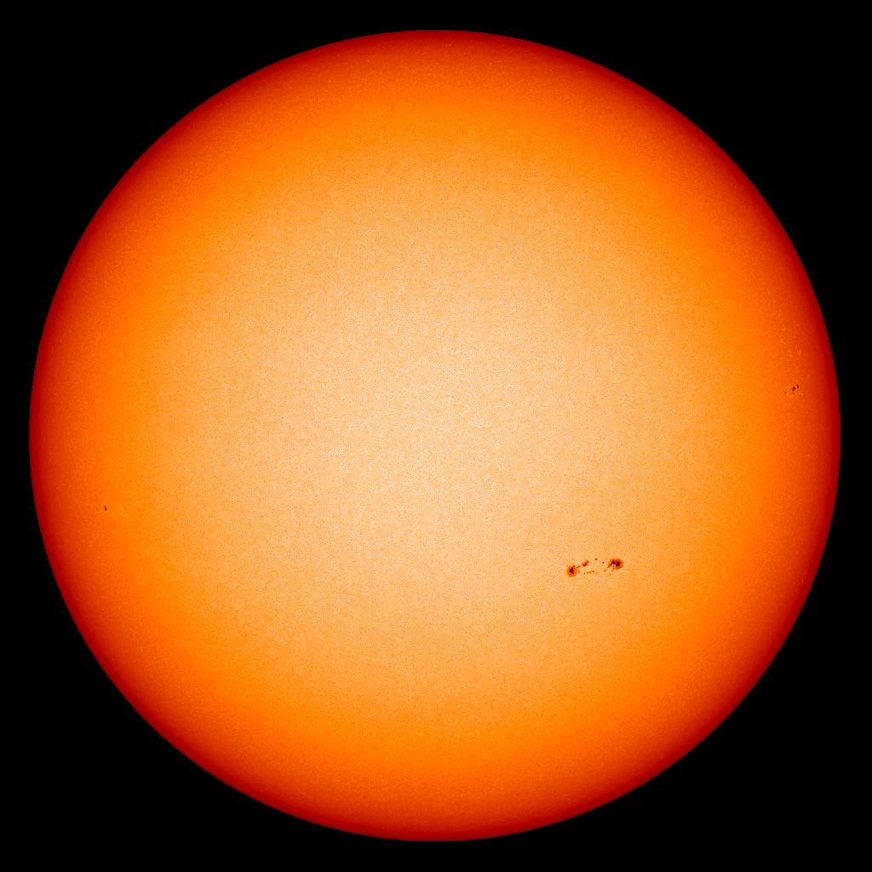
Instrument Overview : PMI
B
γ
Observational parameters :
Products : vector magnetograms (B, γ, φ), line-of-sight velocities (v_{LOS}) continuum mapping (I_{c})
FoV : full Sun + alignment margin
Spatial resolution : 2.2’’
Cadence : 30 min
Critical issue:
PHI etalon non-availability → etalon development crucial pre-development
φ
ν_{LOS}
I_{c}

Slide 9
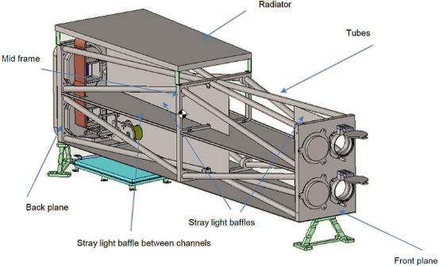
Instrument Overview : EUVI
Observational parameters :
Wavelength : three bands centred on Fe XII 195Å, He II 304Å and Fe VIII/XXI 131Å
FoV : 42.6 x 61.3’ extended towards Earth (λ dependant)
Spatial resolution : >3.2’’ (λ dependant)
Cadence : <5 min (λ dependant)
Critical issue:
Funding → descope to SWAP-type instrument (195Å)

Slide 10
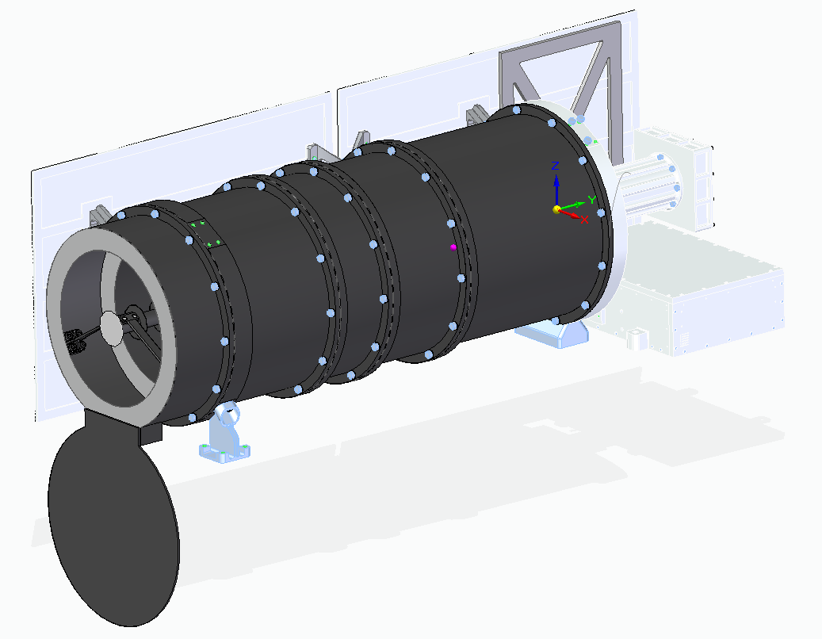
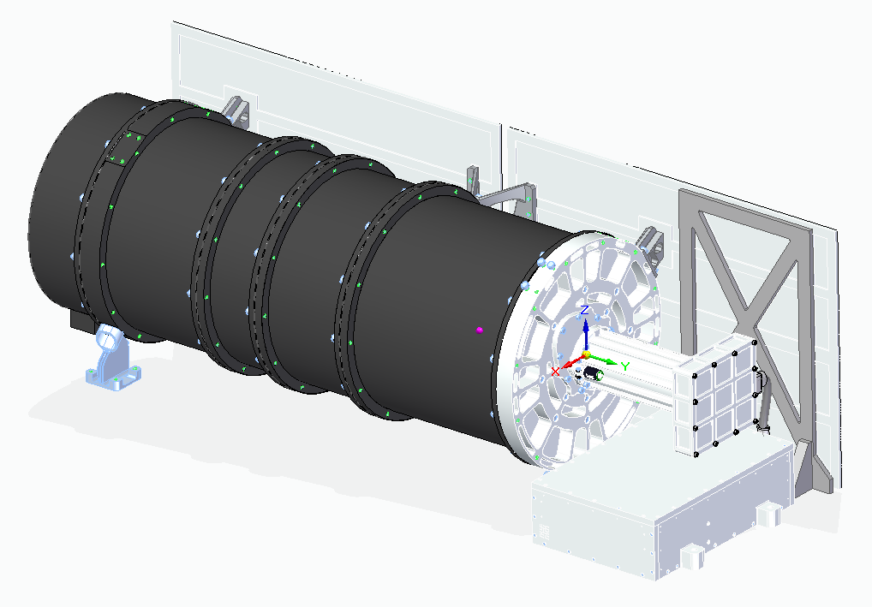
Instrument Overview : COR
Observational parameters :
Wavelength : 500 – 700 nm
FoV (radial) : 2.7 – 25 Rsun
FoV (azimuthal) : 360º
Spatial resolution : 1.5’
Cadence : 5 min
Critical issue:
Recent SCOPE optical testing at CSL → some modification required

Slide 11
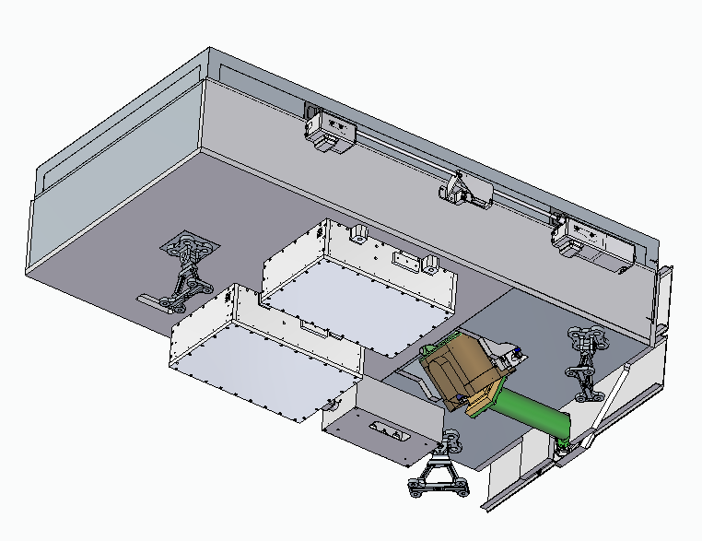
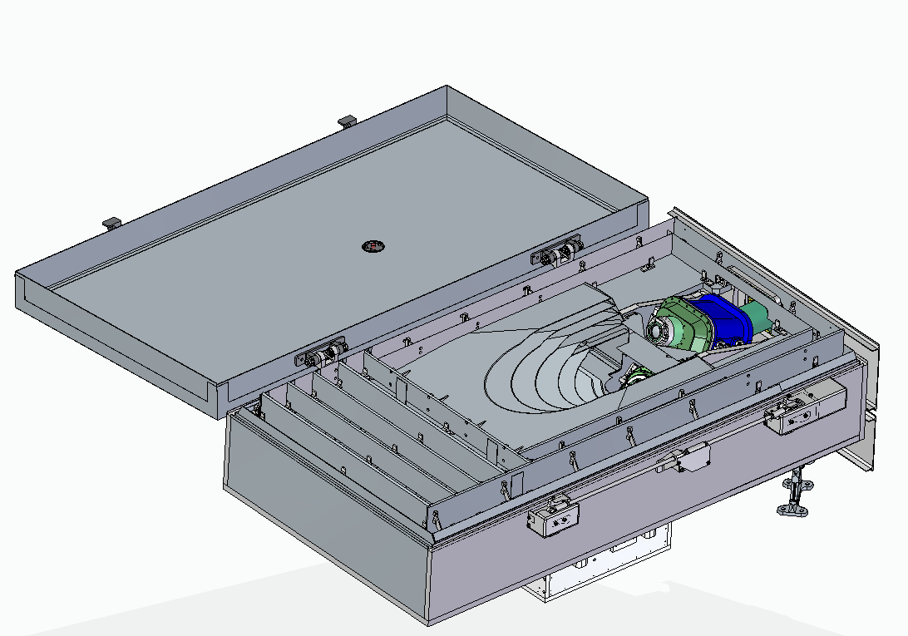
Instrument Overview : HI
Observational parameters :
Wavelength : 600 (500) – 750 (900) nm
FoV (radial) : 4 – 70º elong
FoV (azimuthal) : >60º (over 5 – 55º)
Spatial resolution : 3.5’ (6’)
Cadence : 30 min
Critical issue:
FEA analysis reveals additional stiffening required (shutter)

Slide 12
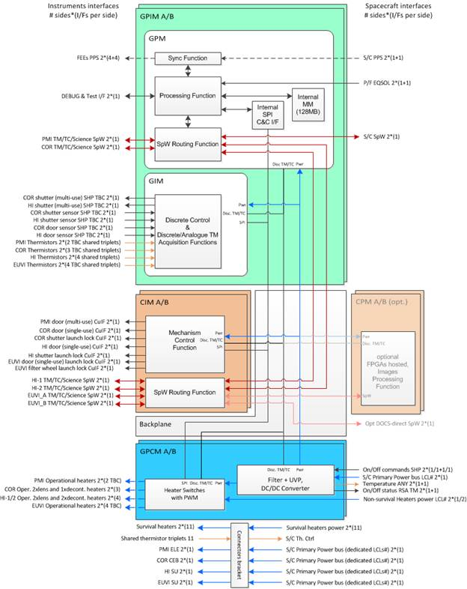
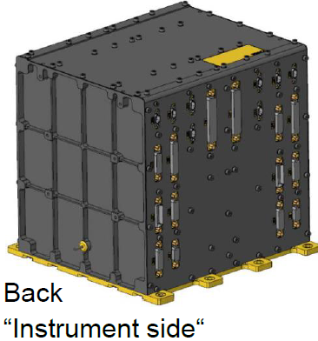
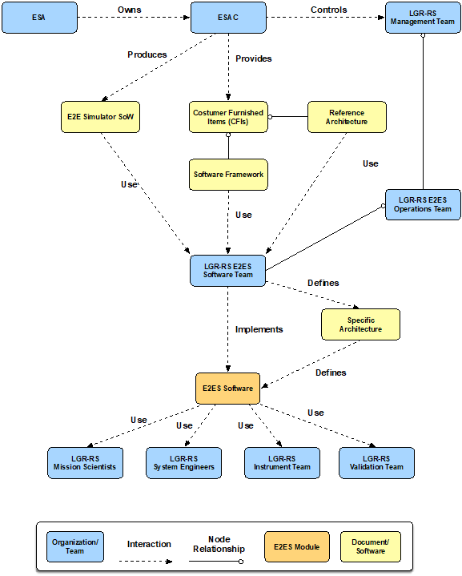
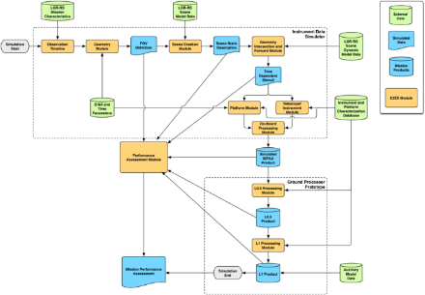
Overview : ICPU & G&F
Design based on five modules, three based on heritage (Generic) solutions (GIM, GPM, GPCM) and two application specific (Custom) modules (CIM and optional CPM).
Standard approach (built on Space Science E2E Mission Performance Simulator Reference) tailored to required high-level architecture, and modules defined. Working on the specifics for each instrument.

Slide 13

In-situ Package
Jonathan Rae
Mullard Space Science Laboratory, University College London
On behalf of the LGR in-situ consortium

Slide 14
Instrument | Operational Requirement | Requirement | Heritage
Fluxgate magnetometer MAG (IC/Graz) | IMF Strength and orientation; forecast input into ENLIL and others | 1s | Solar Orbiter/JUICE/MMS
Plasma Analyser PLA (MSSL) | Bulk plasma measurements for CME arrival time, magnitude, solar wind transients, geomagnetic forecasts | 1s | Solar Orbiter
Medium Energy Particle Spectrometer MEPS (Kiel) | SEPs; ~ few hours warning of SEP onset during gradual events | 30s | Stereo/Solar Orbiter
Radiation Monitor RM (PSI) | Radiation environment; ~100s keV-GeV electron-ions-heavier ions | 1min | POLAR/NGRM/RADEM
X-ray Flux Monitor XFM (Isaware) | Solar X-ray activity and flares | 1 min | Chandrayaan/Bepi
Data Processing Unit DPU (IAP/CAS) | Single interface with the spacecraft | - | THOR

Slide 15
Key Science Requirements
Magnetic field
  IMF 0.1-200nT at 1nT accuracy
Solar Wind bulk properties
  70eV-33keV
  200-2500 km/s
  0.2-150 /cm3
  0.04-1 MK
Solar Energetic Particles
  30keV-8MeV ions, 30keV-0.6MeV electrons
Radiation Environment
  1-500MeV protons, 0.1-8MeV electrons
X-ray photon flux
  0.1-0.8nm c.f., GOES

Slide 16
Thanks

