Slide 1
The NASA STEREO mission

Slide 2
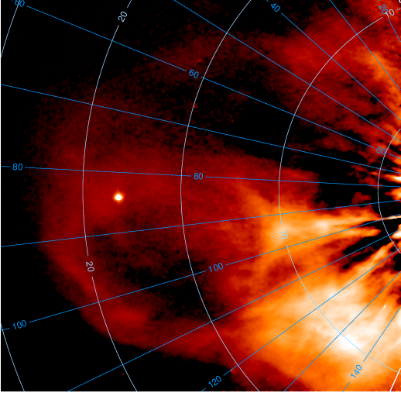
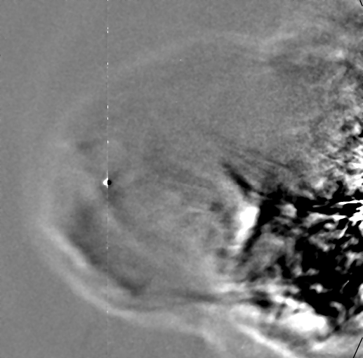
Introduction
Goal of STEREO - Study the onset and evolution of solar wind structures – particularly CMEs but also CIRs/SIRs – as they propagate through the inner heliosphere out to 1 AU and beyond. Specific focus on Earth-directed events.
STEREO Heliospheric Imagers - developed and built by a UK-led consortium, comprising the University of Birmingham and RAL, with CSL (Belgium), and NRL (USA). Since launch in October 2006, the HI PLS programme has been led by RAL.
The remaining remote sensing instruments (two coronagraphs, EUV imager – on both spacecraft) also include UK camera systems.

Slide 3
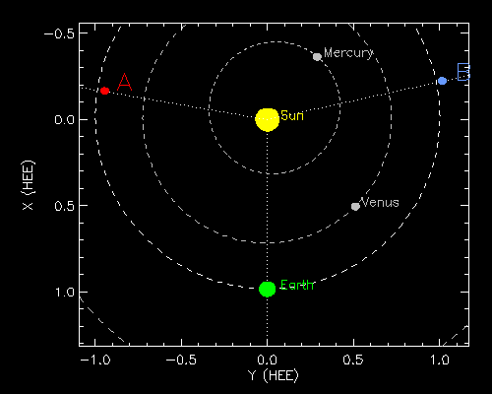
STEREO Mission Status
Over 12 years have elapsed since launch. As of today, STEREO-A and STEREO-B are both ~100º from the Sun-Earth line.
Both spacecraft passed through superior conjunction early in 2015. STEREO-A emerged fully operational. Unfortunately, prior to entering superior conjunction, contact with STEREO-B was lost. Recently, regular attempts to recover contact with STEREO-B have been suspended.
STEREO-A is fully operational.
STEREO is in extension phase; the 2017 NASA Senior Review for Heliophysics approved funding to 2020 (under the assumption that STEREO-B is not recoverable), with an invitation to participate in the 2020 Senior Review.
Over 330 refereed HI papers; 15 PhD theses from UK/Ireland; 15 UK user groups; 10 other countries use HI data

Slide 4
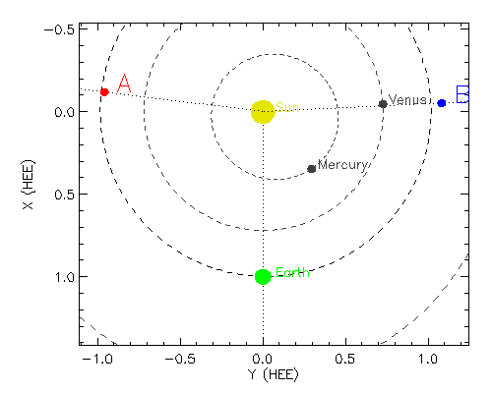
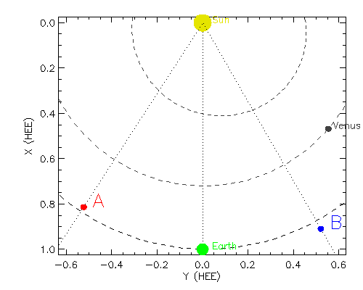
STEREO/HI Strategy
The return to prime location
During the period April 2019 to April 2022 STEREO-A will move from 97º to 34º from the Sun-Earth line, passing through L5 in October 2020.
This is the prime location for the study of Earth-directed solar wind events.
While the outward passage through this region was during deep minimum, this passage will be characterised by increasing solar activity.
We envisage enhanced interest in the STEREO/HI observations for both scientific analysis and underpinning space-weather science.
1 April 2019
1 April 2022

Slide 5
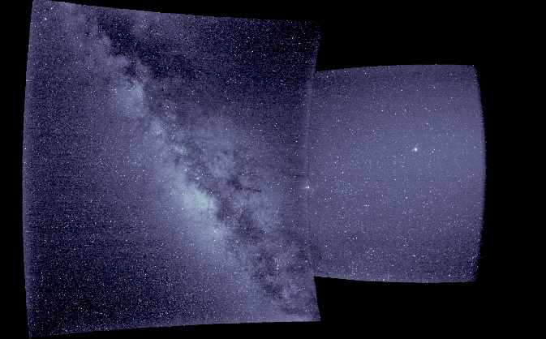
STEREO/HI PLS
STEREO/HI Strategy
STEREO/HI Strategy
The role of STEREO in the expanding fleet of heliospheric spacecraft
Parker Solar Probe (launched August 2018) and Solar Orbiter (due for launch February 2020) and also BepiColombo (launched October 2018) provide unique opportunities for ‘ground-truth’ in-situ measurements of solar wind phenomena imaged by STEREO/HI.
With these missions joining the current fleet of heliophysics spacecraft during the 2019-2022 period, this provides unique opportunities for coordinated remote sensing and in-situ observations of inner heliospheric solar wind structures.
Many people talk of the Grand Solar Observatory; the unprecedented international study of our star and its impacts is one of the jewels of the international space programme in which the UK has invested significantly; our scientists are at the forefront of its development and exploitation.

Slide 6
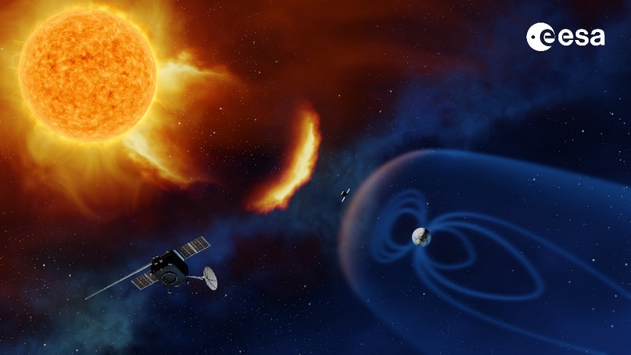
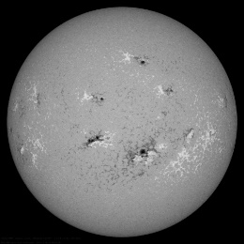
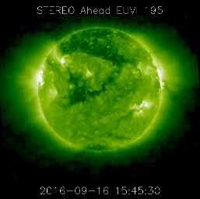
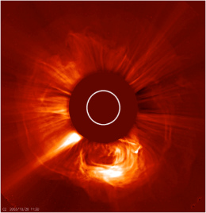
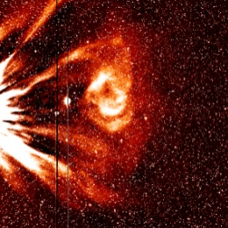
STEREO/HI Strategy
Space weather
Space weather remains a high priority for UK government; the UK is the largest contributor to Period 3 of ESA’s Space Situational Awareness (SSA) programme.
Under SSA, ESA is developing a space weather monitoring mission to L5 (Lagrange), acknowledging advancements in space weather prediction due to STEREO.
A heliospheric imager is a key element of the Lagrange payload.
Hence, increased concern over space weather is corresponding to an increase in activities that seek to maximise the space weather potential of heliospheric imagery.
Lagrange Remote-Sensing Package

Slide 7
The HI Team
The RAL STEREO/HI team comprises elements of the following staff members:
Principal Investigator – Professor Richard A. Harrison
Project Scientist/PRO – Dr Jackie A. Davies
Support Scientist – Dr David Barnes
Instrument Manager – Dr Chris J. Eyles
Calibration Scientist – Dr S. James Tappin
Data/Software Manager – Mr Steve R. Crothers
UKSSDC Manager – Mr Matthew N. Wild
The PLS support covers the operational/service aspects of STEREO/HI – research is covered by the STFC.
Website: https://www.stereo.rl.ac.uk/
E-mail: richard.harrison@stfc.ac.uk or jackie.davies@stfc.ac.uk

Slide 8
STEREO/HI Exploitation
Topical coverage of the STEREO/HI publications includes:
CME onset, propagation, evolution, impact*
CIR/SIRs*
CME-CME and CME-CIR interactions*
Stellar variability (including novae)
Exoplanets
Cometary physics
Interplanetary dust
Asteroids and planets
F-corona/zodiacal light
Cosmic rays
*science & space weather
See https://www.stereo.rl.ac.uk/

Slide 9
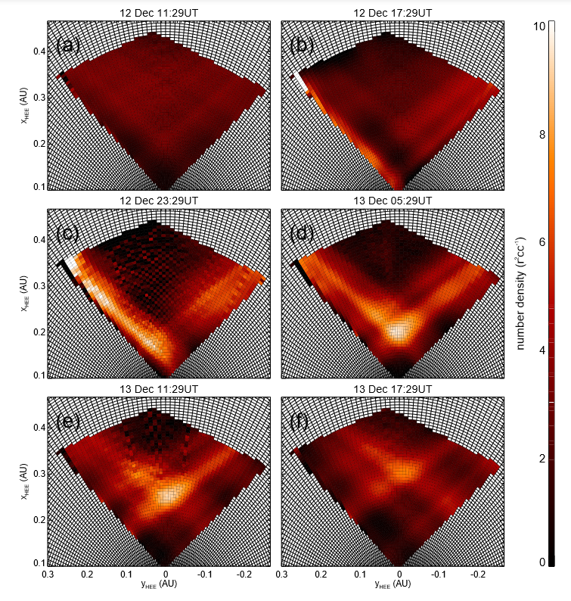
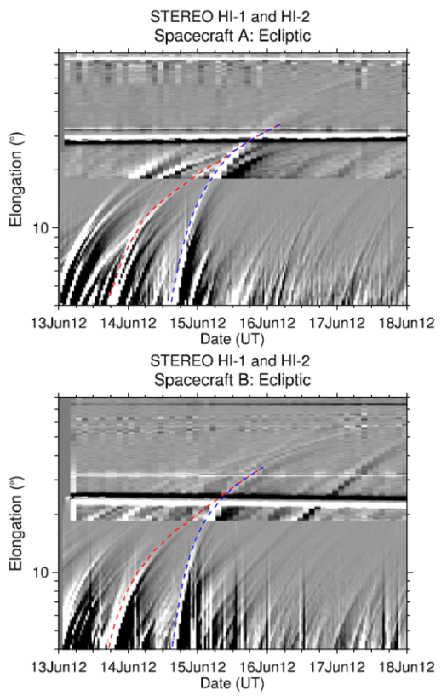
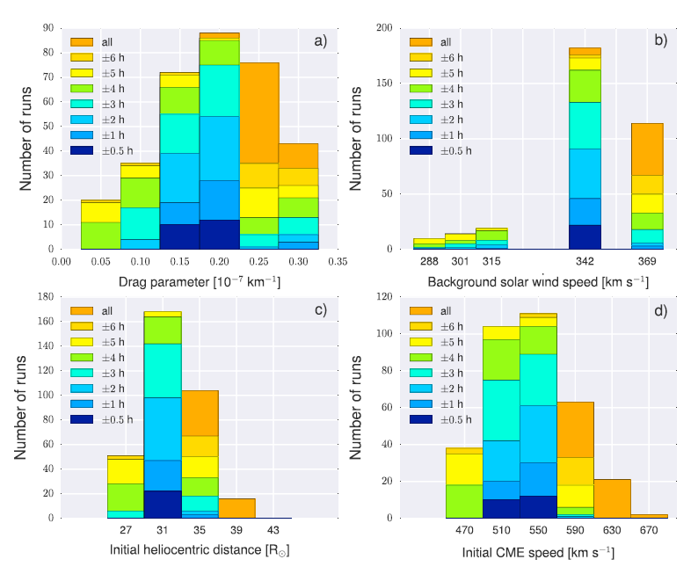
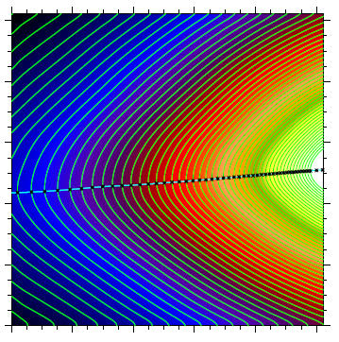
Scientific Highlights
Some new publications
Barnes et al., 2018, (submitted): First demonstration of tomographic reconstruction of HI imagery.
Srivastava et al. (2018, Solar Phys 295, 5): Study of the kinematics of two interacting CMEs launched from the same active region. The interaction led to the strongest sudden storm commencement of the present Solar Cycle (24), of duration ~ 20 hours).
Amerstorfer et al. (2018, Space Weather 16, 784): Demonstration of an ensemble method of predicting CME arrival, based on HI images.
Stenborg et al. (2017, ApJ 848, 57) : Analysis of the F-corona between 2008 and 2012 as observed by HI-1.

Slide 10
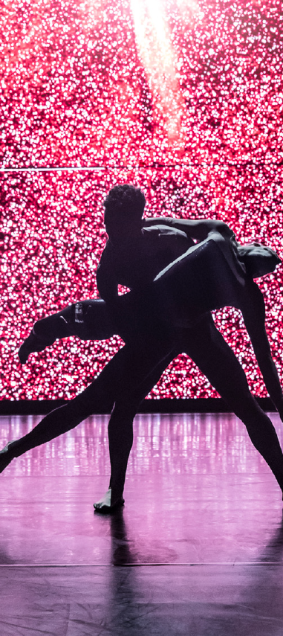
Outreach Highlights
8 MINUTES

