Slide 1
2018 Solar Missions Forum
The PUNCH Mission
Jackie Davies: UK Science Lead

Slide 2
PUNCH
Polarimeter to Unify the Corona and Heliosphere
One of five Heliophysics Small Explorer (SMEX) missions selected to conduct an 11-month concept (Phase A) study
PI: Craig deForest, from Southwest Research Institute (SwRI), Boulder, US
Through polarized Thomson-scatter imaging of the transition from corona to heliosphere, PUNCH will advance our understanding of (1) how coronal structures fuel the ambient solar wind with mass and energy, and (2) the dynamic evolution of transient structures in the young solar wind (near the source surface).

Slide 3
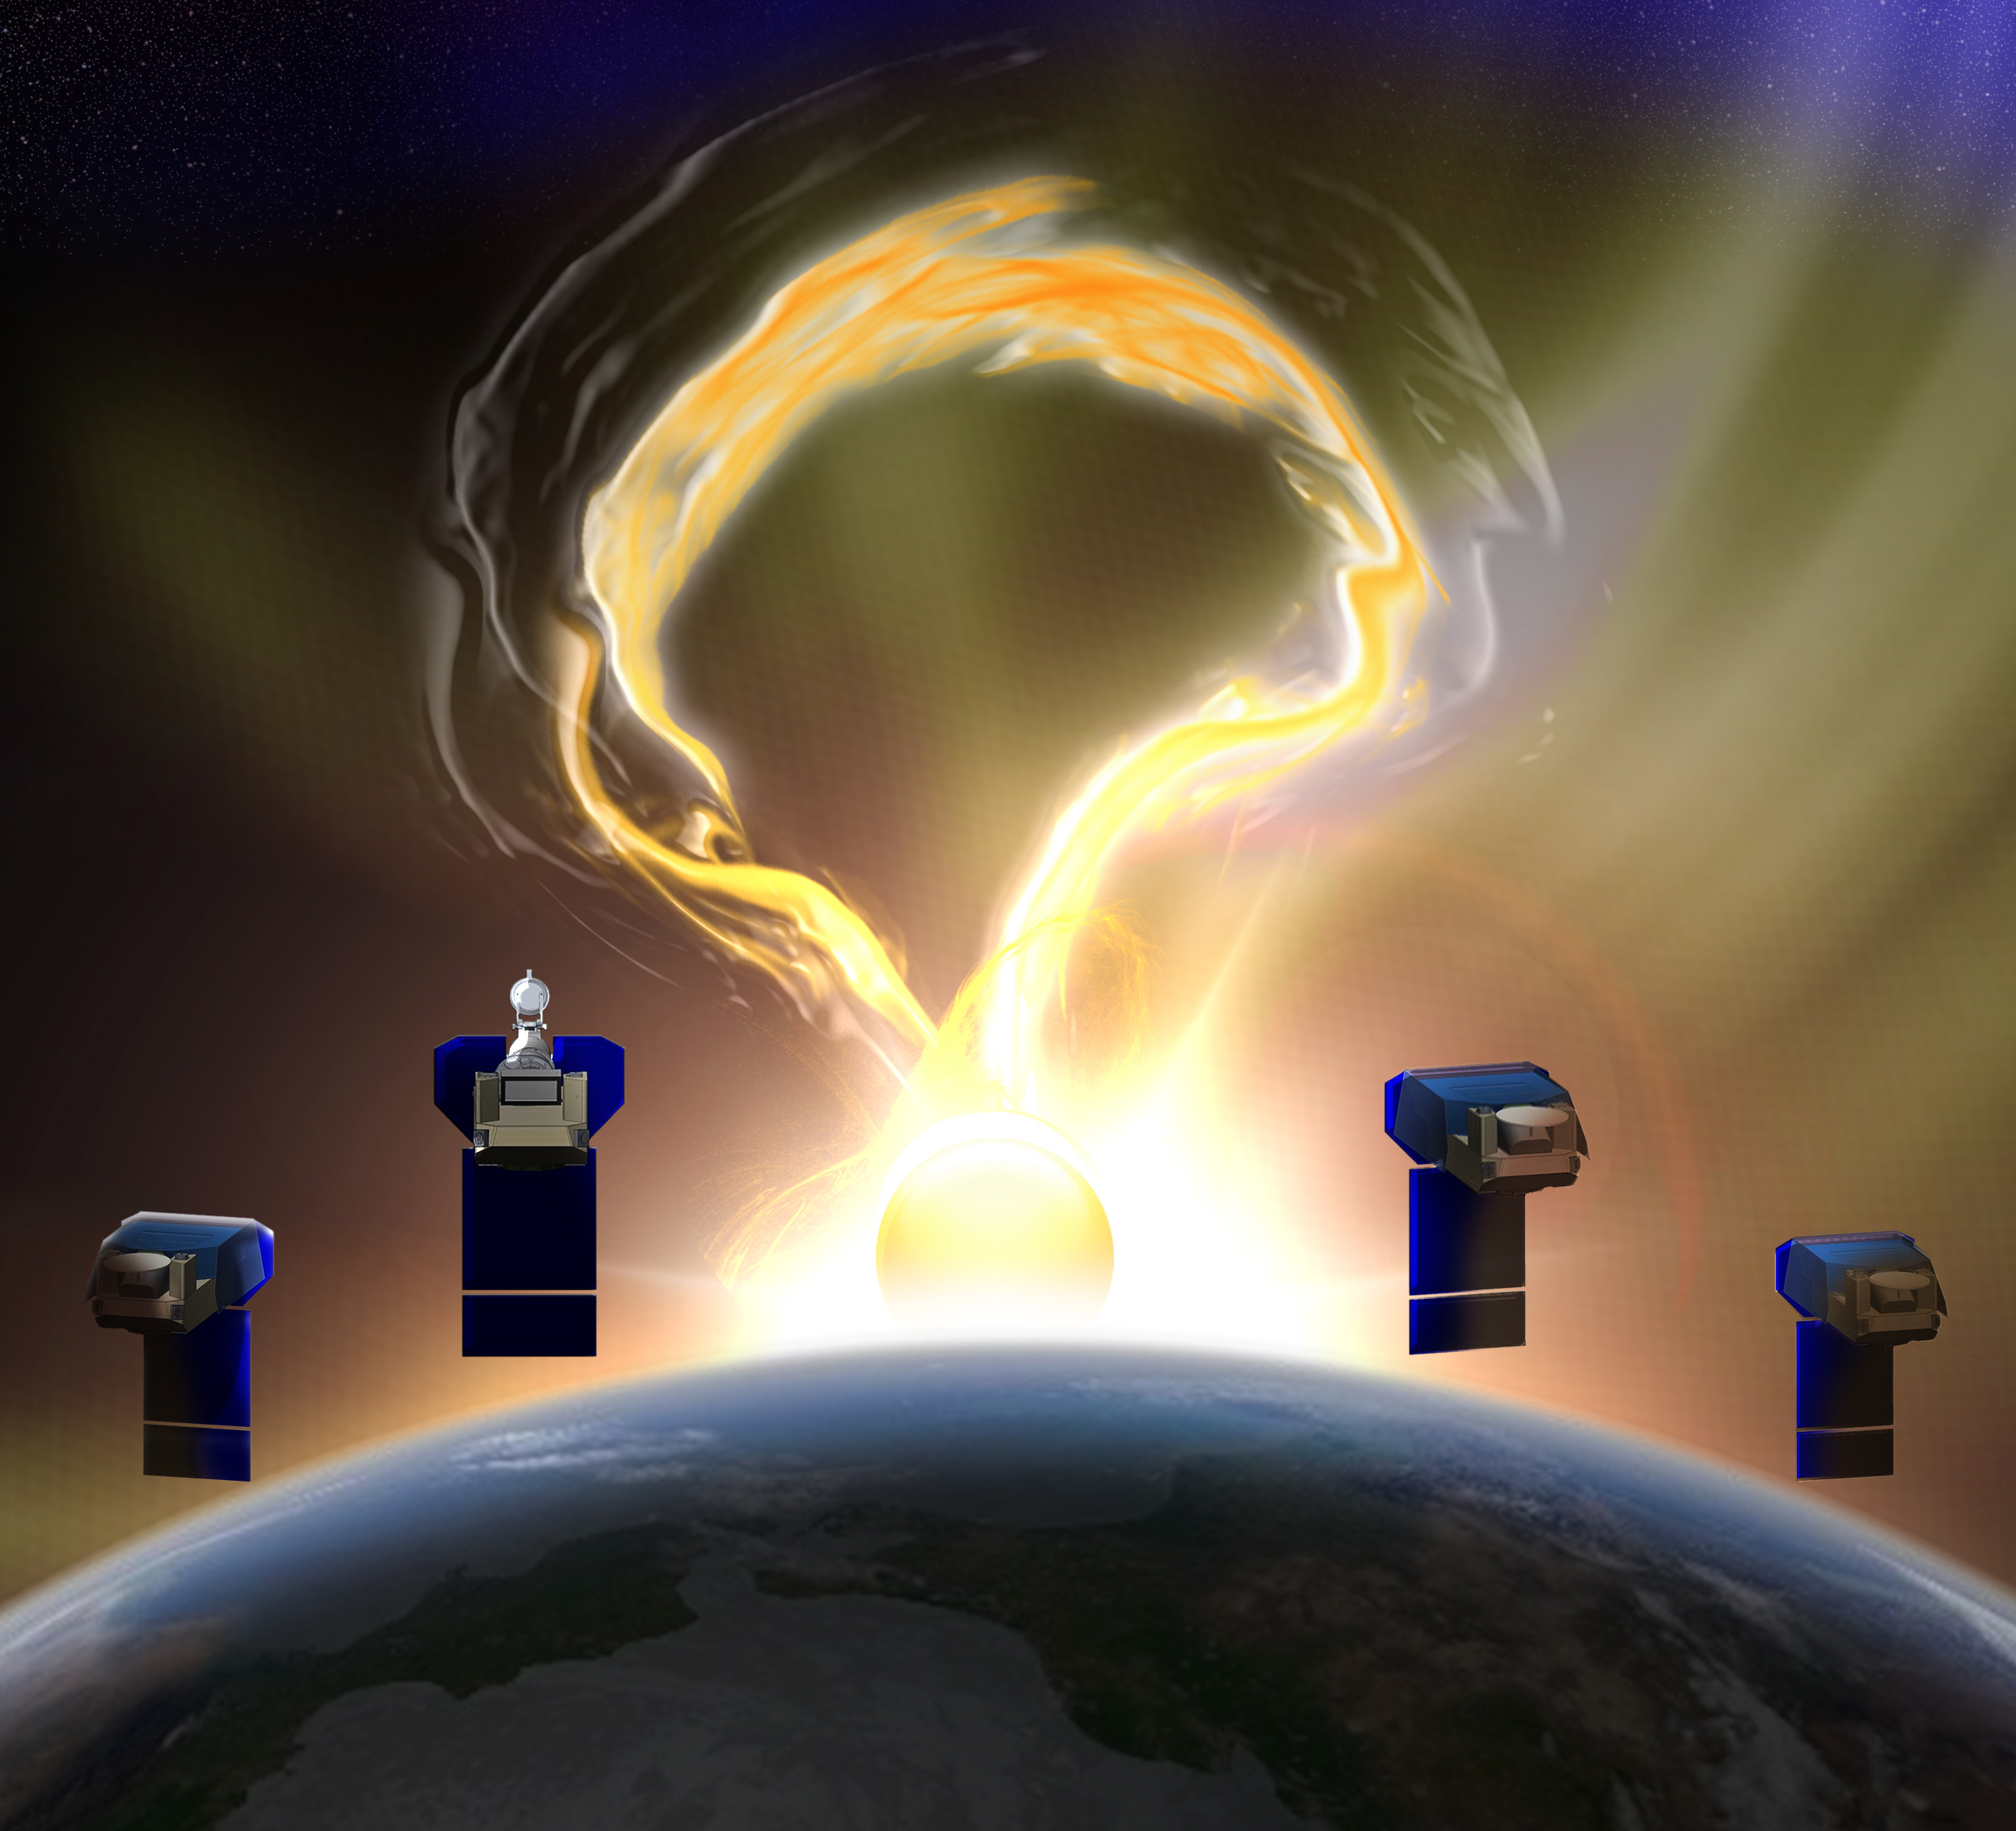
Four LEO smallsats
One narrow-field imager
Three wide-field imagers
Synchronized operation
Rapid deep-field imaging
Polarization for 3D inversion
PUNCH Mission Structure

Slide 4
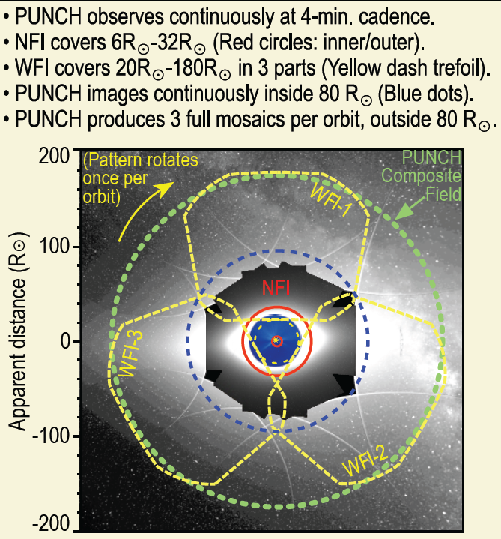
PUNCH Observing Strategy
Sun-synchronous twilight LEO
Cameras are synchronized & matched in wavelength
pB & B measurements: 4-min cadence

Slide 5
PUNCH Science Strategy
PUNCH Timeline
Launch 2022

