Slide 1
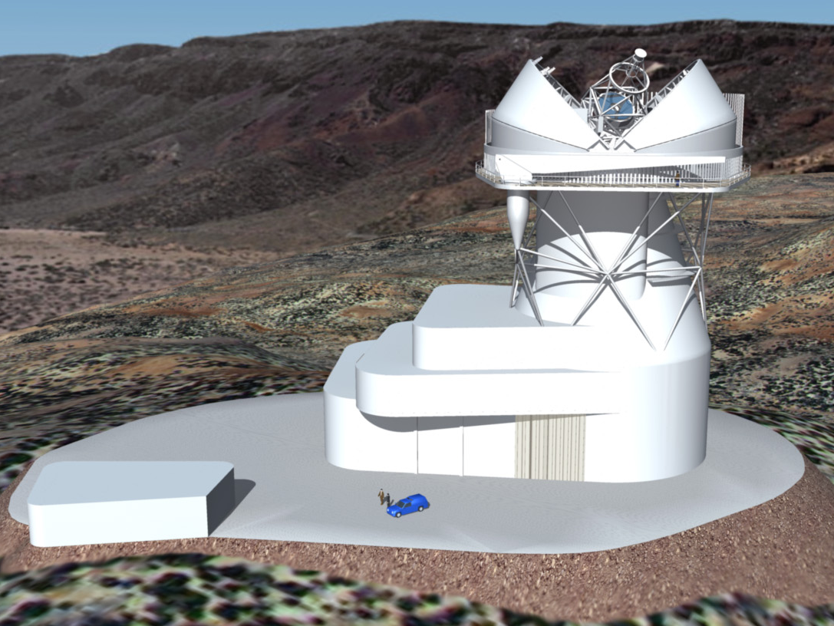
EST: The European Solar Telescope
Sarah Matthews¹, Mihalis Mathioudakis², Robertus von Fay-Siebengurgen³ and the EST team ¹UCL-Mullard Space Science Laboratory, ² QUB, ³University of Sheffield

Slide 2
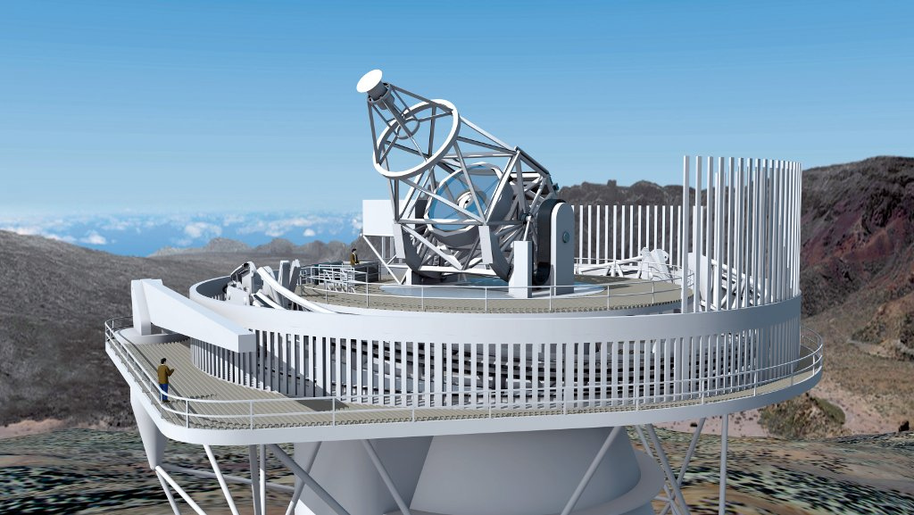
EST Design baseline
4-metre diameter
On-axis Gregorian configuration
Alt-Az mount
Simultaneous instruments
Broad-band imagers
Narrow-band tunable imagers
IFU spectrographs
AO/MCAO integrated in the optical path – first time

Slide 3
How is EST different to DKIST?
EST has a polarimetrically compensated on-axis design. The Mueller matrix is 1 and is constant in time. EST can achieve the same polarimetric accuracy as DKIST in average conditions, where DKIST requires exceptional seeing.
EST will have MCAO/AO integrated in the optical train from construction – FOV over which diffraction limit can be achieved will be larger.
On-axis design is lighter and more compact – EST can be higher above ground where seeing is better.
EST spectrographs will all be IFUs
EST light distribution allows for simultaneous observation of minimum 3 lines (not currently possible with DKIST)
EST will have access to the NUV, down to the atmospheric cut-off
Notes:
1. EST has an on-axis polarimetrically compensated design and the Mueller matrix is unity and constant in time. While DKIST can achieve the same polarimetric accuracy, it requires exceptional seeing to do this; EST will achieve it in average conditions. 2. Despite the critical importance of the chromosphere, there are relatively few chomospheric diagnostic lines available, which are formed at different heights within the atmosphere, and their simultaneous observation is required for energy flow to truly be tracked though the atmosphere; critical for understanding all types of energy transport. EST’s light distribution system and IFU spectrographs will allow for simultaneous observation of a minimum of three of these lines at any given time, allowing for unprecedented sampling with height. DKIST’s light distribution does not currently allow this. 3.EST’s spectrographs will all be based on IFUs. As well as providing simultaneous spectral information across the FOV, necessary for rapidly changing features, this has two further advantages: (1) in the chromosphere plasma motions are mainly parallel to the field lines. At e.g., 45° inclination to the line of sight, two points connected by a field line and separated in height by 1000 km will appear separated in the image by 1”. Their connectivity can only be studied if they are observed simultaneously. (2) Differential refraction causes the same point on the Sun to fall on a different position on the focal plane for different wavelengths, and the difference may be as large as a few arc seconds. While differential refraction can be taken into account with vertical slits, the vertical direction is rotating on the solar surface as the sun moves on the sky, rendering a slit spectrograph a poor solution. Truly simultaneous observations at different wavelengths can only be achieved with a 2D input. 4. EST has the potential to access the near-UV down to the atmospheric cut-off. This allows studies of Balmer continuum in solar flares and provides a wealth of polarimetric diagnostics that will not be accessible by DKIST.

Slide 4
Current status
Final design work and preparations for legal structure are funded by H2020 INFRADEV II until 2021.
Science Advisory Group has been re-vamped and is updating science requirements, including possible additional instrument.
STFC solar physics facilities review concluded and we re-submitted an SoI for UK involvement – waiting to hear….
H2020 SOLARNET follow-on proposal is being prepared.
Follow EST developments:
https://twitter.com/estsolarnet
https://www.facebook.com/EuropeanSolarTelescope/
https://www.instagram.com/european_solar_telescope/
https://www.youtube.com/user/ESTtvCHANNEL

Slide 5
Primary science goals
What is the role of small-scale magnetic field concentrations in the evolution of the magnetic field?
How is energy transported from the photosphere
to the chromosphere?
What is the role of small-scale processes in the large-scale release of energy in solar flares and CMEs?

Slide 6
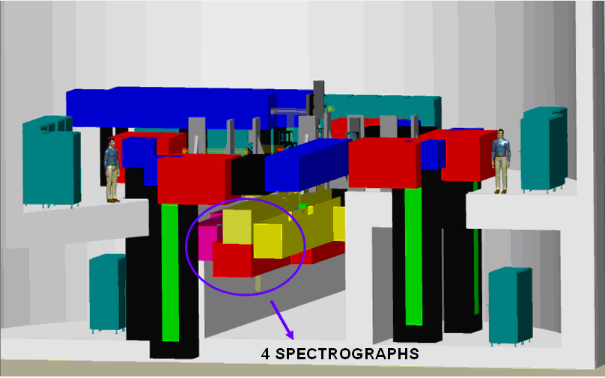
Telescope and instrumentation key requirements
High angular resolution, with AO and MCAO for atmospheric distortion correction
High precision polarimetric capabilities, for accurate magnetic field determination
Simultaneous observation of photosphere and chromosphere
But….
Small patch of the Sun at high spectral & spatial resolution in narrow spectral range => photon starvation.
Polarimetric measurements at required sensitivity to accurately measure small-scale fields are even worse…

