Slide 1
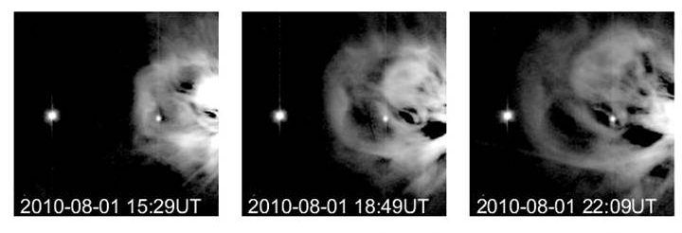
STEREO
Richard Harrison
Principal Investigator STEREO/Heliospheric Imagers
Jackie Davies
Project Scientist STEREO/Heliospheric Imagers
Notes:
1

Slide 2
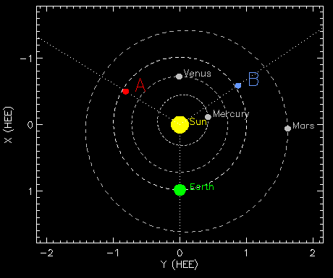
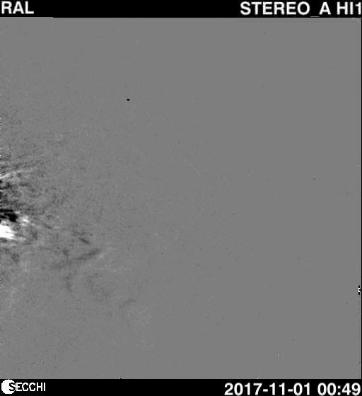
NASA’s STEREO mission: The 3D Sun & Sun to Earth studies of solar ejecta
Earth-Sun-S/C angles (11/1/2018):
A = 121.8º, B = 124.1º
Launch Oct 2006 - 11 years science operations
Superior conjunction phase: 2014/15
STEREO-A fully operational
STEREO-B daily attempts to recover
Further mission extension approved by the Senior Review (to 2020)
UK role - PI instrument (HI) & all camera systems

Slide 3
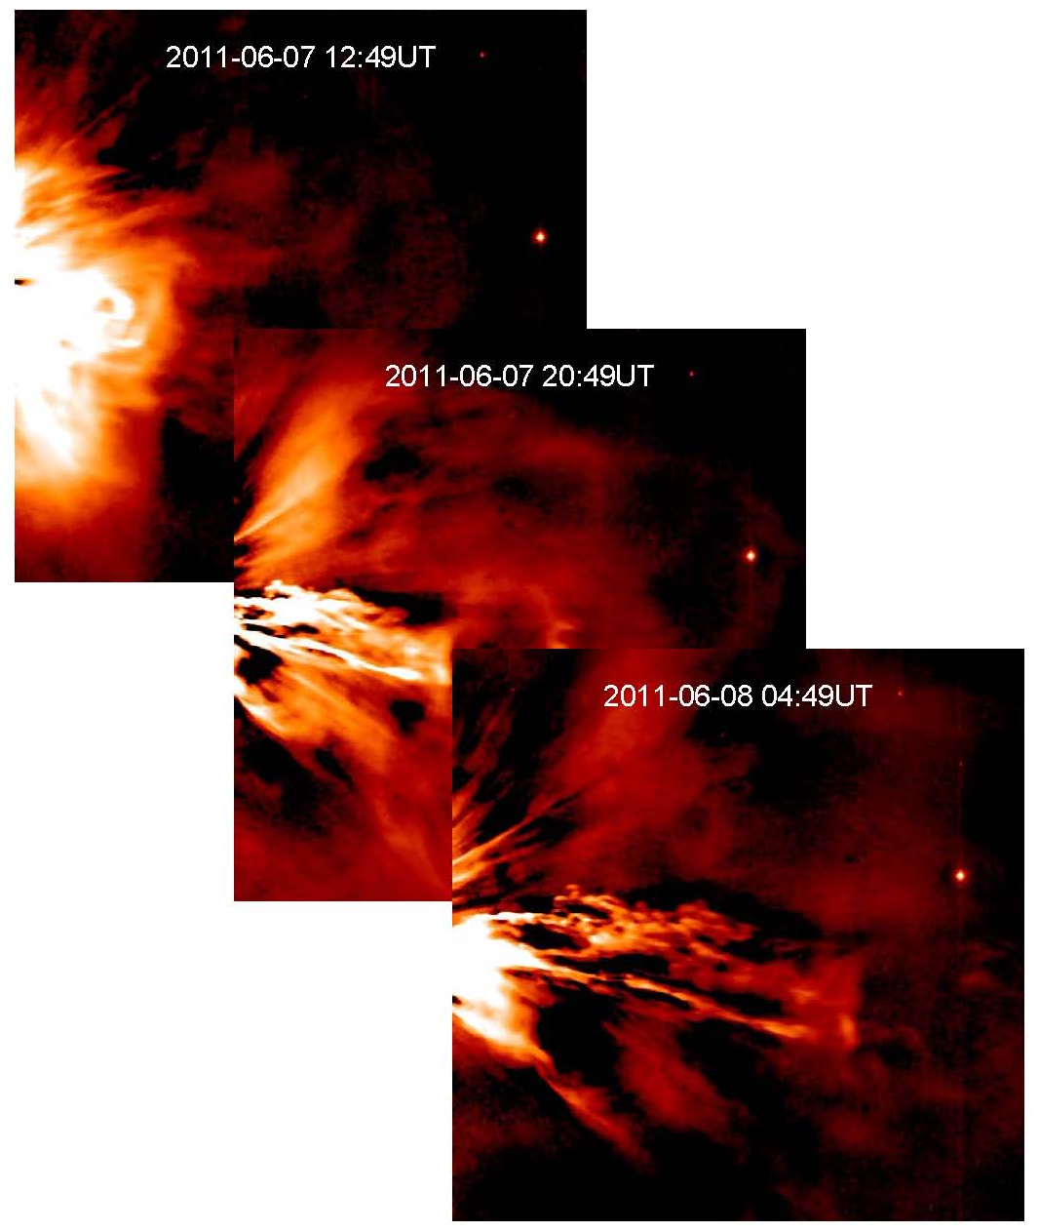
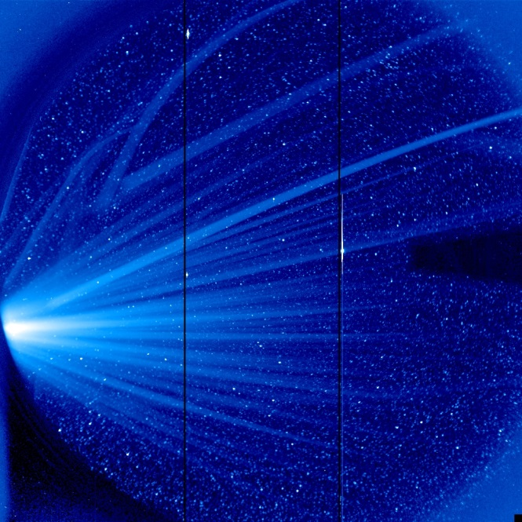
HI Science Exploitation
298 publications (Sept 2017)
15 PhD theses
CME onset, propagation, evolution and impact (science and space weather)
CIR/SIRs
Stellar variability, incl. novae, exoplanets
Cometary physics
Interplanetary dust
Asteroids and planets
F-corona
[See HI website]

Slide 4
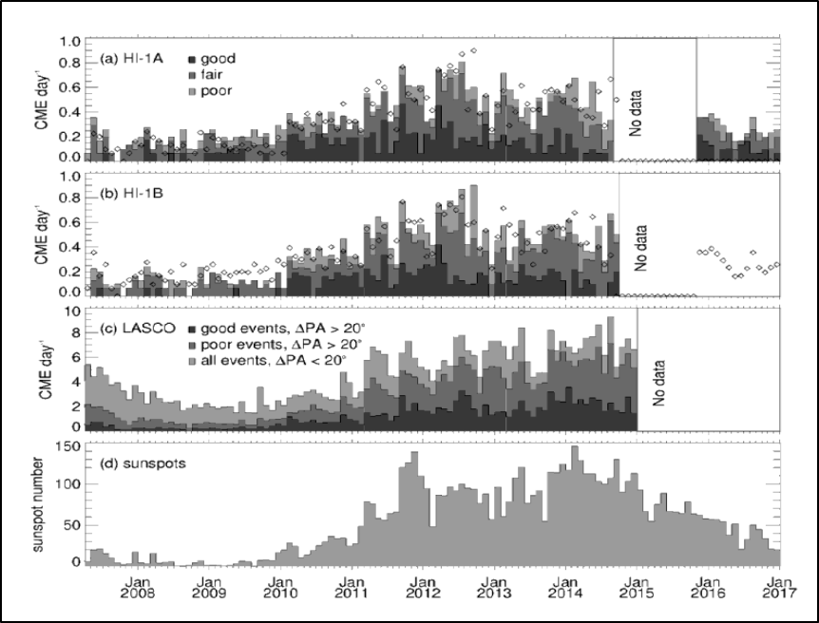
Monthly CMEs rate per day for (a) HI-A and (b) HI-B. (c) Corresponding rate from LASCO CDAW catalogue. (d) Monthly sunspot number. (Harrison et al., 2017, Solar Phys. Under review) [778 & 732 CMEs for HI-A & B, 2007-2014]

Slide 5
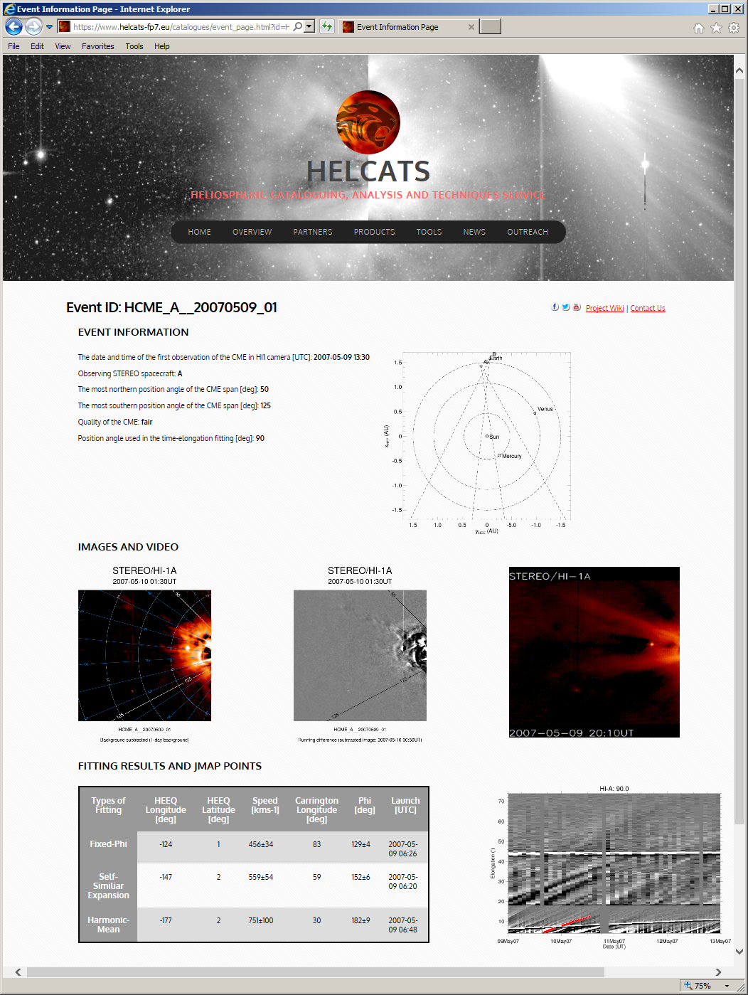
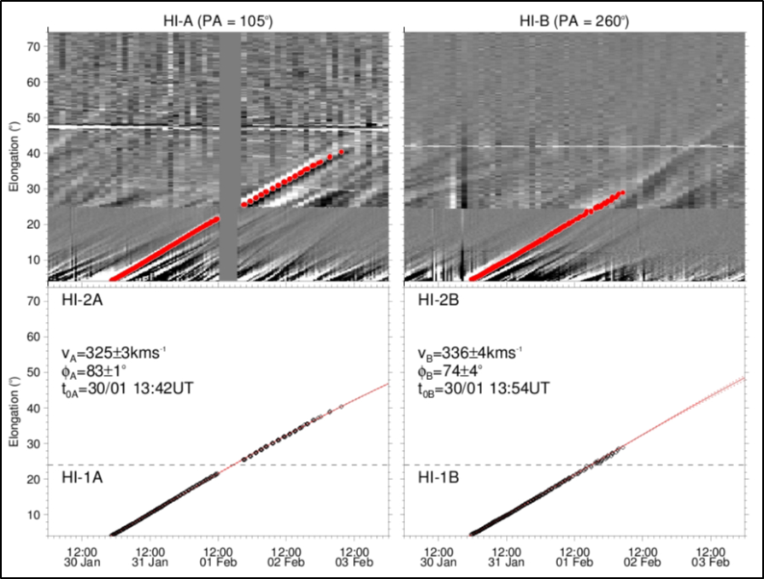
STEREO/HI Event list HIGeoCAT

Slide 6
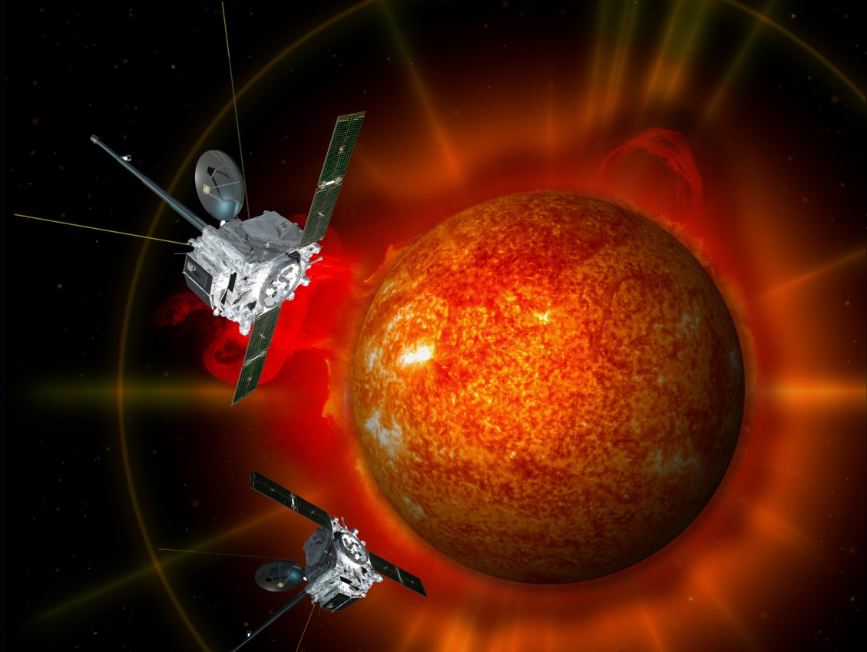
NASA’s STEREO mission: The future, and synergy with Solar Orbiter
No real consumable or station-keeping issue and instruments in good health (STEREO-A)
Spacecraft returning to ‘prime’ locations – e.g. STEREO-A at L5 in 2020, near Earth in 2024
Continued off-Sun-Earth synergy with near-Earth instruments
With S.O. launch in Feb 2020, offers multi-angle opportunities with context ‘global’ solar and heliospheric imaging, including tracking of events seen by S.O. and Parker Solar probe.

Slide 7
RAL Team & Contact Info
The RAL STEREO/HI Post Launch Support (PLS) team comprises elements of the following staff members:
    Principal Investigator – Professor Richard A. Harrison;
    Project Scientist/PRO – Dr Jackie A. Davies;
    Support Scientist – Dr David Barnes;
    Instrument Manager – Dr Chris J. Eyles;
    Calibration Scientist – Dr S. James Tappin;
    Data/Software Manager – Mr Steve R. Crothers;
    UKSSDC Manager – Mr Matthew N. Wild.
UK STEREO HI website – www.stereo.rl.ac.uk

Slide 8
Spare slides

Slide 9
STEREO/HI PLS
STEREO Mission Status (ii)
A carrier from STEREO-B was detected on 21 Aug 2016, during a routine monthly attempt to regain contact. Contact was lost again on 23 Sept.
The spacecraft was found to be in an uncontrolled attitude, spinning about its principle axis of inertia once every ~2 mins.
2 of 11 battery cells had apparently failed, leading to low main bus voltage.
Despite attempts to warm up propulsion tanks and fuel lines, the status of the propellant/propulsion system are unclear.
A momentum dump, which reduced spin from ~3 to ~1 deg/s, enabled lock-on of the star tracker; this was not sufficient to regain attitude control with momentum wheels. A 2nd dump was unsuccessful (may have increased spin).
Having lost contact, recovery efforts initially reverted to a monthly schedule. Since 21 Aug 2017, favourable orientation (and reducing distance from Earth) have initiated a daily recovery schedule.
Recovery of STEREO-B remains a significant possibility.

Slide 10

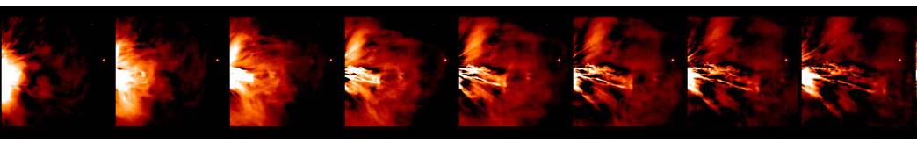
HELCATS: Heliospheric Cataloguing, Analysis & Techniques Service
(www.helcats-fp7.eu)
to catalogue both transient (CMEs) & background (SIRs/CIRs) solar wind structures imaged by the STEREO/HI instruments, including estimates of their kinematic properties based on a variety of established modelling techniques and the prototyping of other, more speculative, approaches;
to verify these kinematic properties, and thereby assess the validity of these techniques, through comparison both with solar source observations and in-situ measurements at multiple points throughout the heliosphere;
to assess the potential for initialising advanced numerical models based on the derived kinematic properties of the transient & background solar wind structures;
to assess the complementarity of using radio observations to detect structures and diagnose processes in the heliosphere (in particular Type II radio bursts and interplanetary scintillation) in combination with heliospheric imaging observations

