Slide 1
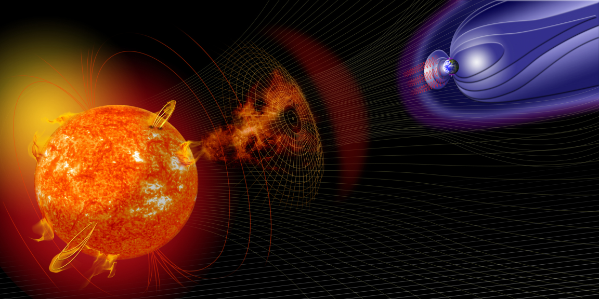
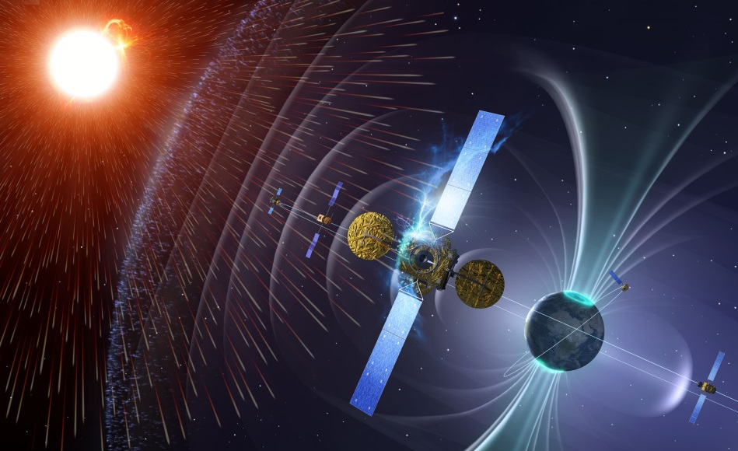
Space Weather and the UK Solar Community
Richard Harrison
Chief Scientist STFC-RAL Space
Notes:
1

Slide 2
Space Weather and the UK Solar Community
Space Weather & the UK Solar Community
Long, successful heritage in solar/heliospheric science missions, and in key scientific research areas
Well placed to apply skills to emerging space weather projects
    Should view this as two arms – science and application – that is our future
    ‘Safety’ in responding to national requirement to address space weather impacts (Nat’l Risk Register of Civil Emergencies)
So, what is happening? Major strategic activities:
    National activities – Met Office/BEIS
    ESA SSA Space Weather programme
    Other activities: UN and COSPAR, UK-US
Notes:
2

Slide 3
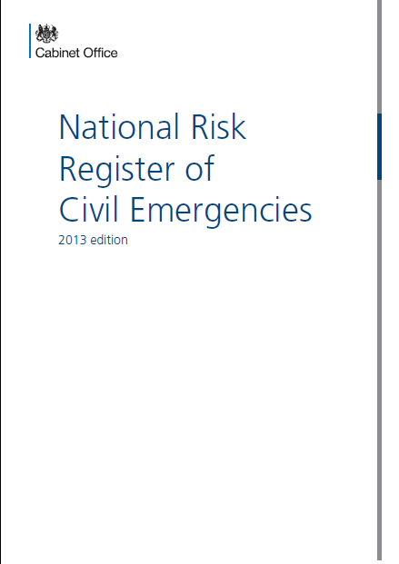
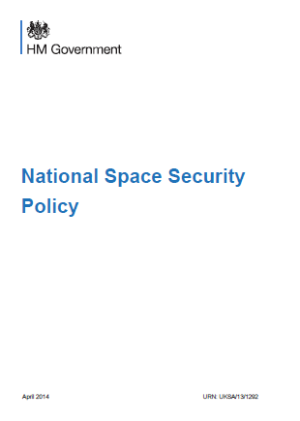
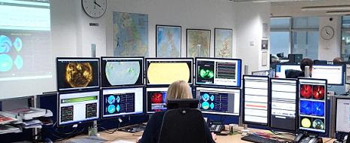
National activities
Space Weather and the UK Solar Community
Extreme space weather on the national risk register. Risk ‘owned’ by BEIS, delegated to the Met Office
Met Office charged with developing and running UK forecasting centre (MOSWOC) – established 2014, one of only two civil space forecasting centres manned 24/7
Partnership between M.O. and science community
Space Environment Impact Expert Group (SEIEG) advises Cabinet Office and BEIS (Chair: Mike Hapgood)
UKSA: Mike Willis Head of Space Weather
Notes:
3

Slide 4
International activities
Space Weather and the UK Solar Community
ESA Space Situational Awareness space weather programme
    Initial definition studies 2009 – UK involvement (Harrison, Hapgood)
    Not part of science programme – need to buy in
    UK has been a major driver of the developing opportunities
UK greatest contributor to SSA Period 3 - €22M (€18M to SW) – with stated emphasis on instrumentation.
Draft Work Plan for 2018 released
SSA/SW recent and on-going projects involving the UK – next slide
Other issues: UK-US, ESA-US, UN? EU H2020 call March 2019 (space weather)
Notes:
4

Slide 5
International activities
Space Weather and the UK Solar Community
ESA SSA basic strategy – Lagrangian L1/L5 missions; Hosted payloads and smallsats; Expert Service Centres (ESC), and more…
RAL, MSSL, IC - L1/L5 Phase 0 Studies (Airbus & OHB) - completed Nov 16
SW Coronagraph (SCOPE) Phase A/B1 study (RAL) [Jackie Davies]
Heliospheric–Expert Service Centre - at RAL (with M.O.) [Chris Perry]
Plasma & magnetic field instrument studies (MAGIC, HOPE, SOSMAG at IC and MSSL)
Lagrange Mission – Remote sensing (led from RAL; Jackie Davies) and In-situ (led from MSSL; Jonny Rae)
Notes:
5

Slide 6
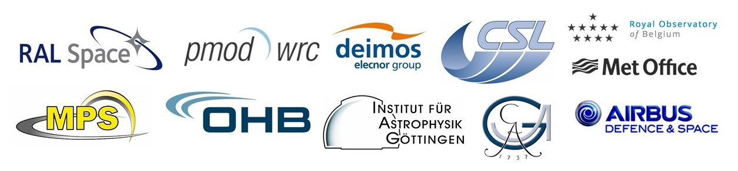

The Lagrange Mission
Jackie Davies

Slide 7
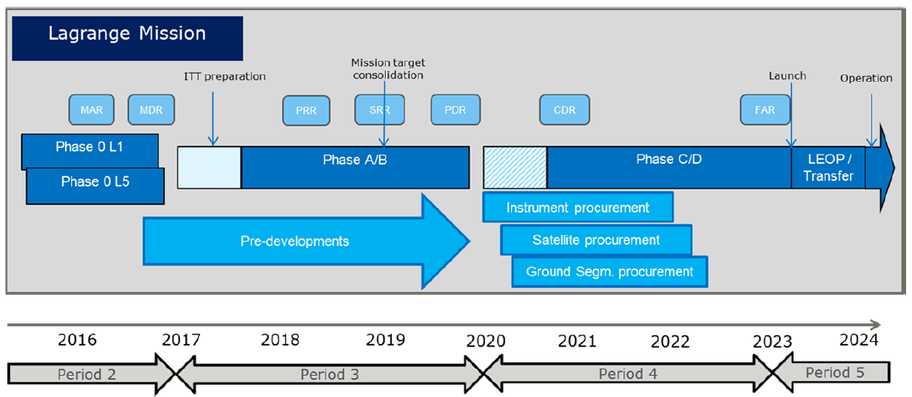
ESA SSA Programme
ESA’s SSA programme comprises four segments: NEO, SST, SWE and (since the start of P3 in 2017) LGR.
The LGR segment focusses on developing a pathway to the launch of a space weather monitoring mission to L5 (L1 backup).
P2 SWE studies defined preliminary mission objectives and assessed the required in-situ and remote-sensing payload.

Slide 8
LGR ITTs
ESA ITT: AO/1-9006/17/DE/MRP : Lagrange Missions Phase A/B1 System Studies (funded through GSP and LGR)
ESA ITT: AO/1-9015/17/DE/MRP : Lagrange Missions In-situ Instruments Phase A/B1 Study & Pre-Developments
ESA ITT: AO/1-9014/17/DE/MR : Lagrange Missions Remote Sensing Instruments Phase A/B1 Study & Pre-Developments
Role | Lead | Collaborator | Collaborator
Consortium lead | RAL (Jackie Davies) | ─ | ─
PMI : Photospheric Magnetic Field Imager | MPS | OHB | ─
EUVI : EUV Imager | CSL | ROB | PMOD
COR : Coronagraph | RAL | UGOE | ─
HI : Heliospheric Imager | RAL | UGOE | ─
IPU (Inst Proc Unit) | ADS-Ge | ─ | ─
G&F Ops | Deimos-UK | Deimos-Ro | RDA
Customer req | UK Met Office | ─ | ─

Slide 9
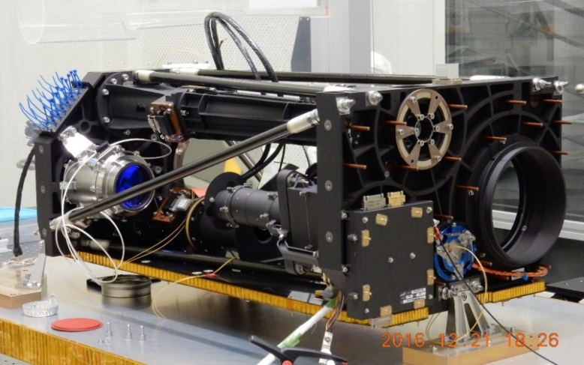
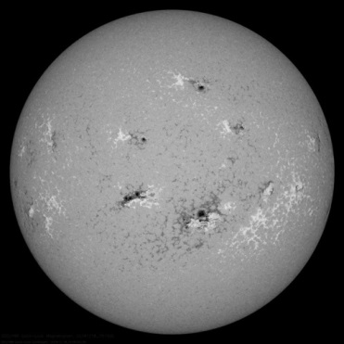
PMI : Photospheric Mag. Field Imager
Monitoring of magnetic activity on the Sun; input to modelling of background solar wind at predict CME arrivalat Earth
L5 view enables such monitoring of that part of the solar disk yet to rotate towards Earth (longer lead-time monitoring/improved background)
Monitoring visible-light continuum (sunspot activity/complexity/development)
Requirements :
Magnetic field map/continuum
Inst type : L-O-S (vector)
FoV : full disk with margin
Spatial resolution* : 5 (2) arcsec
Cadence : 30 (10) min
Mass/power : 25 kg/30 W
Strawman concept : optically-modified version of the (vector) HRT of the Solar Orbiter PHI instrument (PHI flight model delivered April 2017)
* twice the pixel size

Slide 10
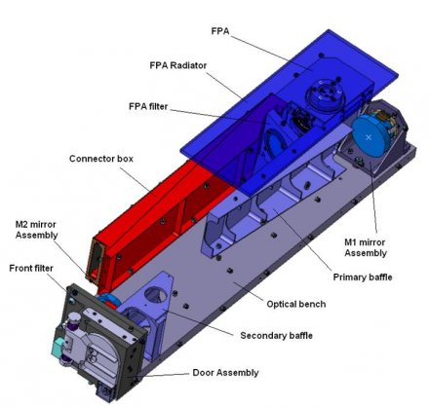
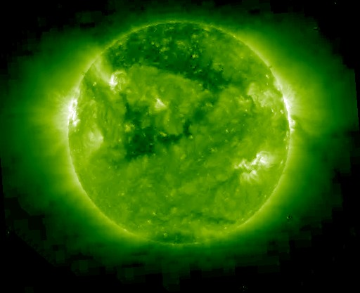
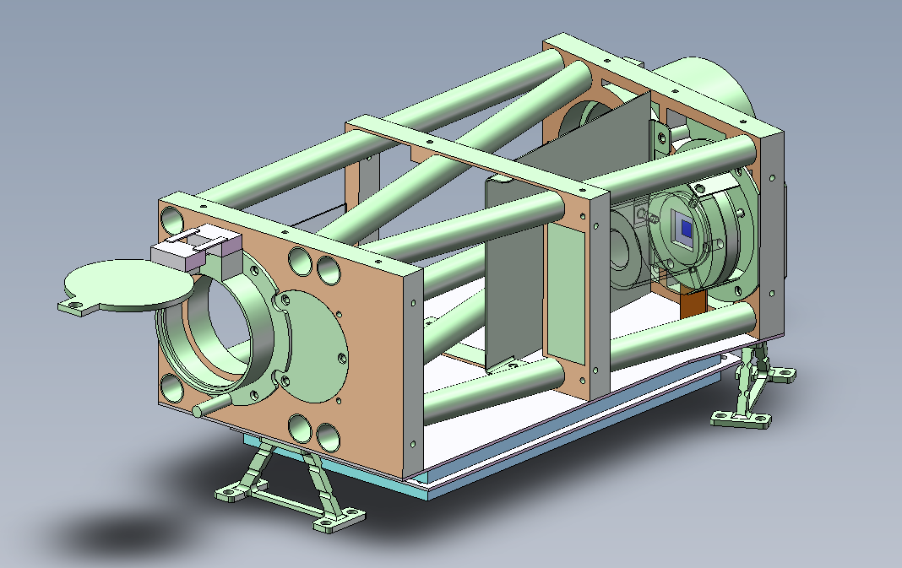
EUVI : EUV Imager
Monitoring structure and complexity of the solar atmosphere, and its evolution, including prominences, active regions and coronal holes
L5 view enables such monitoring of the solar atmosphere on that part of the solar disk yet to rotate towards Earth
Requirements :
Low coronal (chromospheric) images
FoV : full disk with margin
Wavelength : Fe193 Å (Fe193, He304, Fe171, Fe211)
Spatial resolution : 5 (2) arcsec
Cadence : 20 (10) min
Mass/power : 8 kg/10 W
Strawman concept : combines elements of SWAP instrument on PROBA2 and ESIO instrument being studied under GSTP (adapted SWAP optical layout + ESIO thermo-mechanical concept) → duplicate instruments for multiple wavelengths

Slide 11
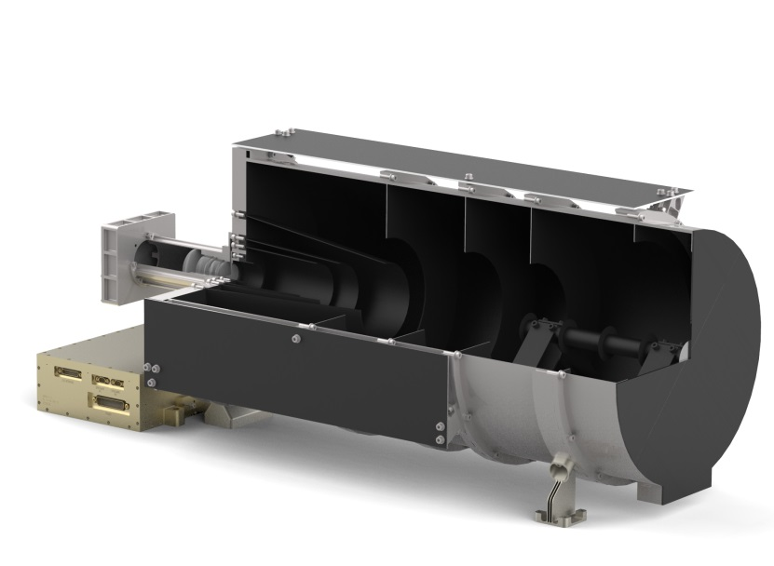
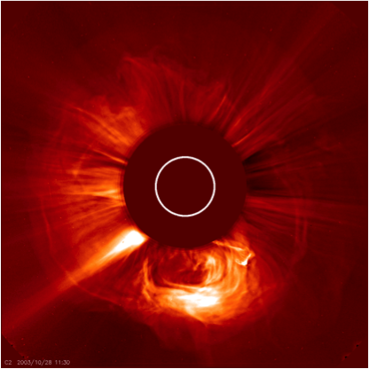
COR : Coronagraph
Earliest definitive confirmation of CME launch
L1 confirms Earth-directed CME, while L1/L5 resolves ambiguity between radial distance and angular width
Basis of CME parameterization for most CME arrival predictions
Requirements:
Visible-light images of the K-corona
FoV (radial) : 3 – 22 (2.5 – 30) R_{Sun}
FoV (azimuthal) : 360°
Wavelength : 500 – 900 nm
Spatial resolution : <2 arcmin
Cadence : 10 (5) min
Mass/power : 20 kg/25 W
Strawman concept : based on the SCOPE instrument being studied under GSTP (OBB currently under manufacture for straylight testing in April)

Slide 12
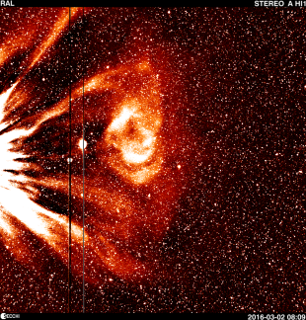
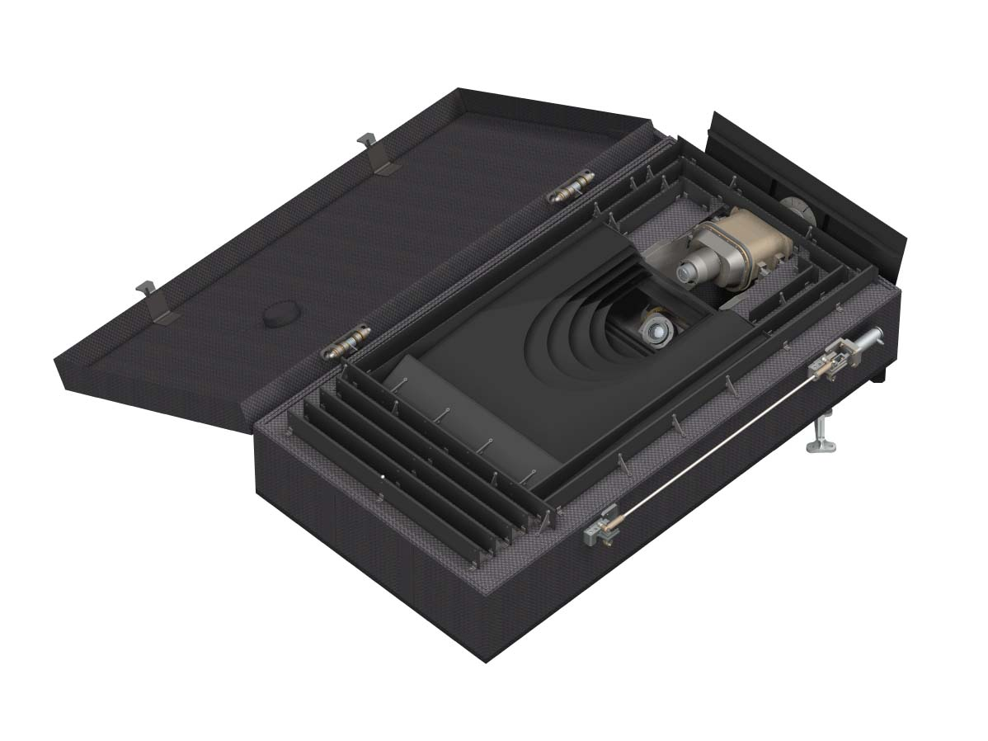
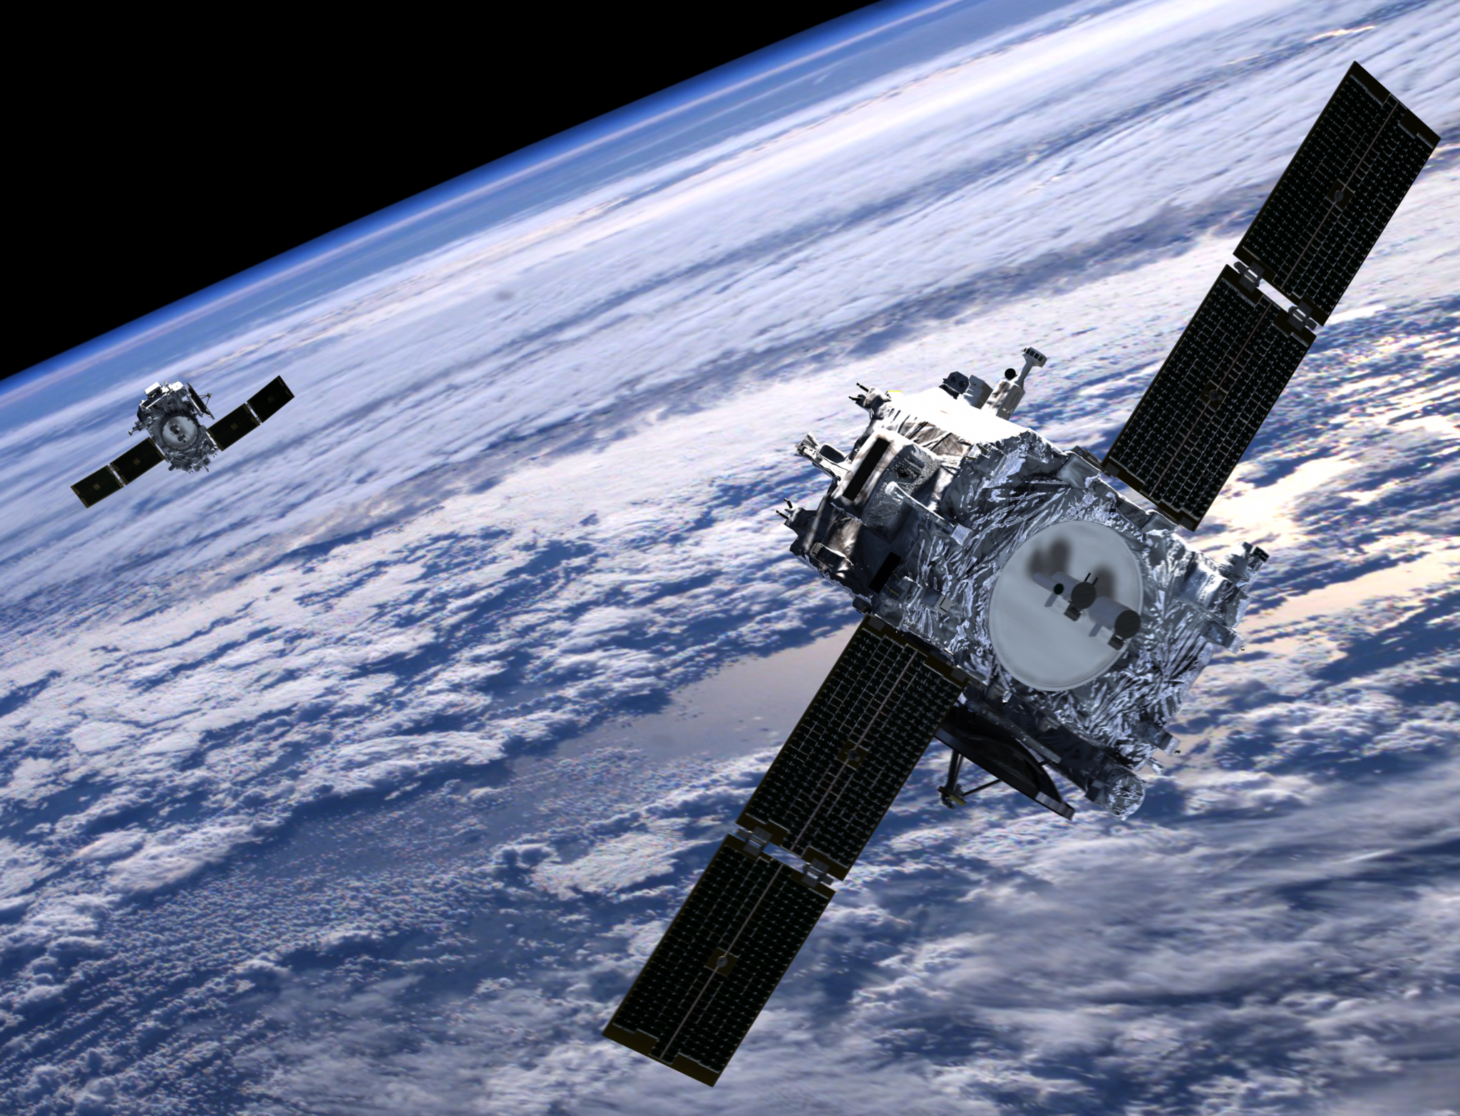
HI : Heliospheric Imager
Fills under-sampled region between corona and 1 AU to mitigate deficiencies in modelling CME arrival based on near-Sun observations
L5 provides clearer side-on view of Earth-directed CMEs out to Earth
Provides additional information on background solar wind
Requirements :
Visible-light images of the heliosphere
FoV (radial) : 10 – 40° (4 – 60°)
FoV (azimuthal) : Towards Earth
Wavelength : 500 – 900 nm
Spatial resolution : ~4 arcmin
Cadence : 60 (30) min
Mass/power : 20 kg/22 W
Strawman payload : modified version of the STEREO/HI instrument (modifications include FoV extent)

Slide 13
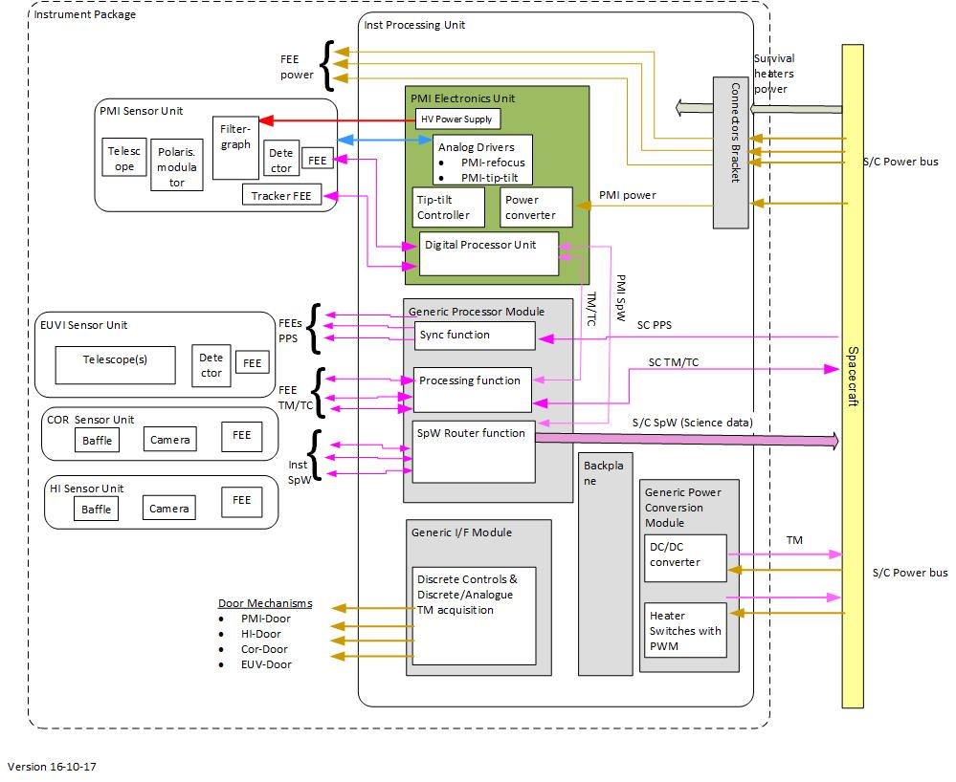
IPU : Instrument Processing Unit
The purpose of the IPU is to provide:
power to the FEE of each RS instrument
thermal control for each instrument
commands to control operational modes
communication link between FEE and S/C
data processing for the RS Instruments, except PMI

Slide 14
Ground & Flight Ops
Analyse the impact of the instruments on:
the operations concept; the flight operations ground segment;
to feed into the system studies.
Analyse the impact of the operations concept on instrument definition/design.
Key task : baseline the architecture/elements of an End-to-End (E2E) Mission Performance Simulator, from observed scene to level 1b products.
PMI etalon development : mitigate discontinued production of Lithium Niobate (LiNb0₃) etalons on PHI
COR optics breadboard : build/test a thermo-mechanically representative breadboard, and test its performance in a representative environment
“Cosmic ray” scrubbing : develop efficient scrubbing algorithm for COR/HI to test in a relevant environment (e.g. on a software emulator of the baselined processor)
Pre-development Activities

Slide 15
Design Considerations
As an operational mission, consideration must be made of:
The need for continuous synoptic observations;
The need for robustness/redundancy [hardware and software];
Operation under extreme space weather conditions [hardware and software];
Cost savings driven by commonalities vs loss of heritage;
Future-proofing to ensure that the operational system can benefit from future improvements in understanding/data analysis/modelling.

