Slide 1
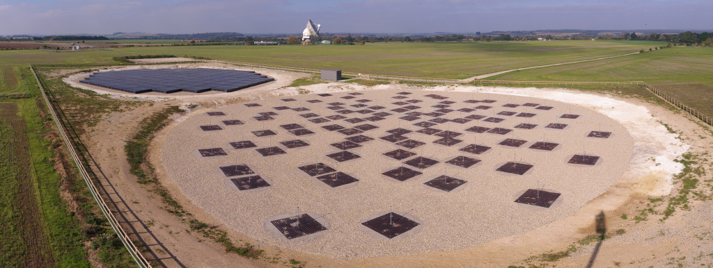
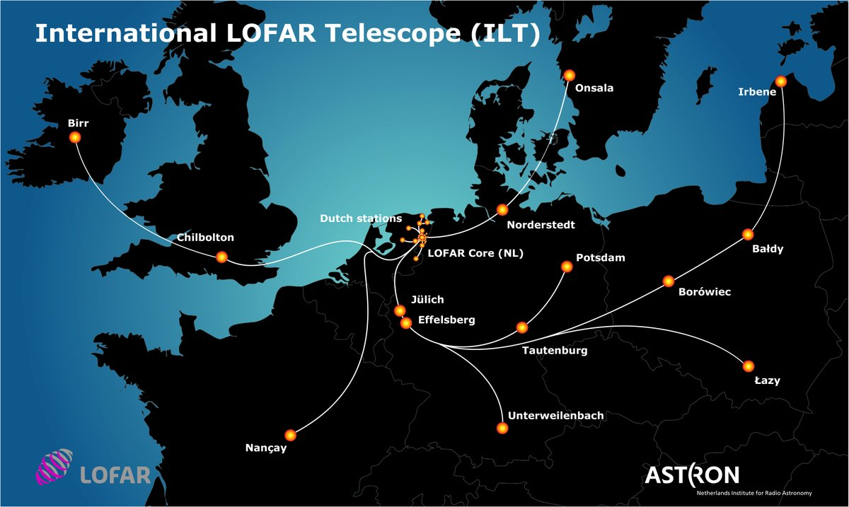
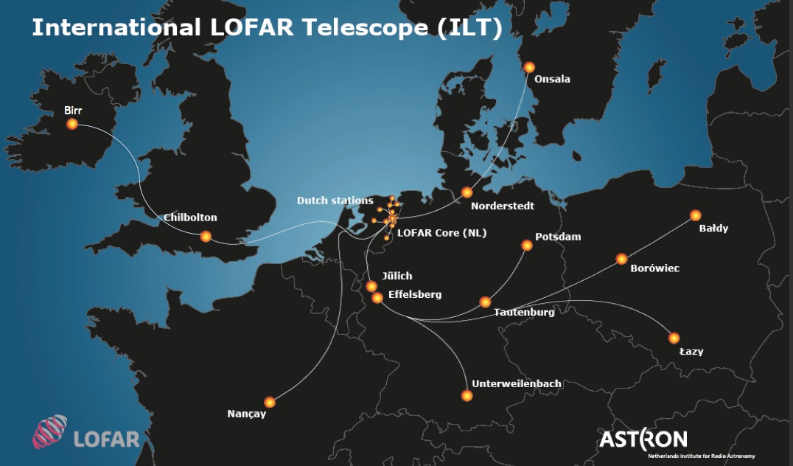
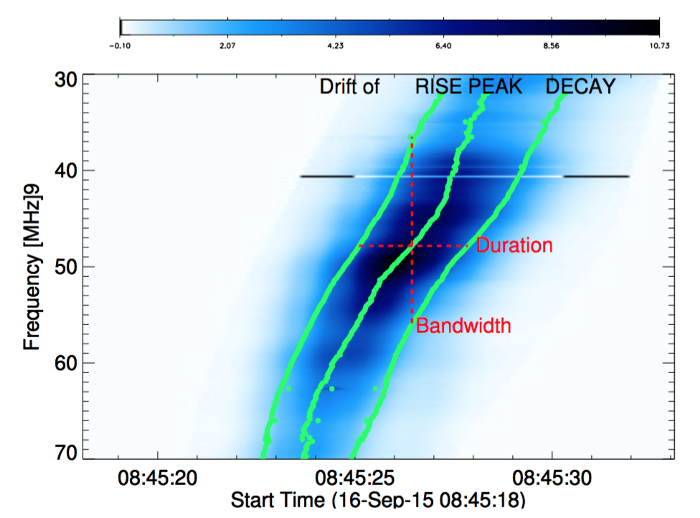
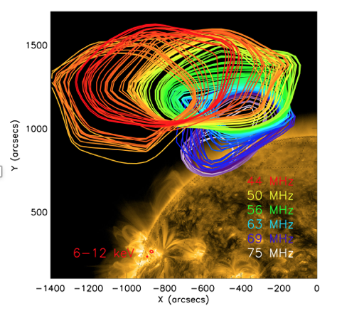
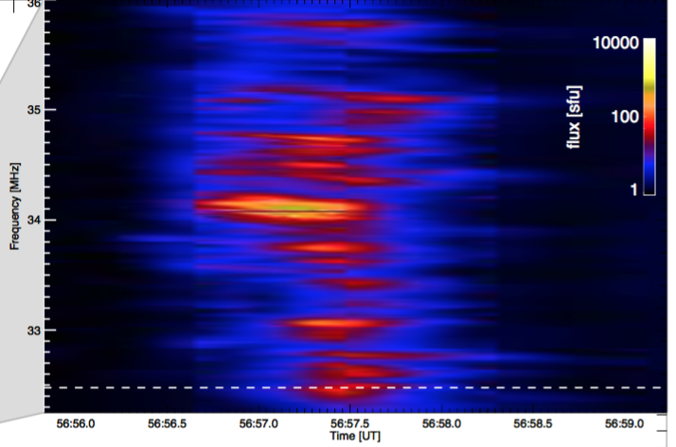
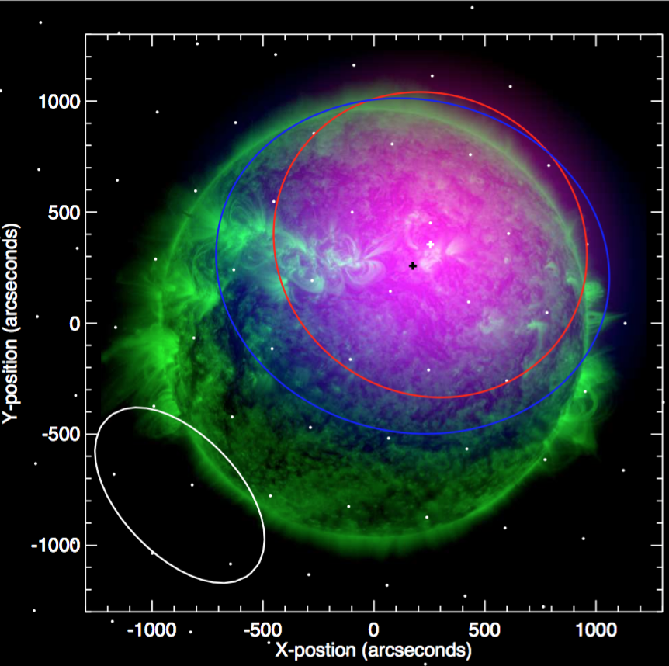
LOFAR - LOw Frequency ARray
Van Haarlem et al 2013
LOFAR is an array of radio antennas distributed across northern Europe, based in the Netherlands.
Solar LOFAR observations allow us to see accelerated electrons as they propagate out from the Sun. $∆t=10ms, ∆f=20 kHz$
Recent Solar LOFAR papers
Reid & Kontar 2018, A&A, accepted
Reid & Kontar 2017, A&A, 606, A141
Morosan et al 2017, A&A, 606, A81
Kontar et al 2017, Nat Comms, 8, 1515
New station in Latvia next year!
Interest from other countries, including Italy
LOFAR 2.0 has been accepted
Correlator improved: Cobalt 2.0
5x processing power.
Additional tied-array beams.
New grant being applied for that will make LBA + HBA observations simultaneously possible.
LOFAR4SpaceWeather
Money obtained from an INFRADEV design study.
Upgrade LOFAR to do space weather monitoring in parallel with radio astronomy observations.
LOFAR wants you!
Interested in radio observations?
Can use LOFAR array or local UK
6 monthly bid for LOFAR time; next one early March 2018
Interested? Contact me (Hamish Reid), Eduard Kontar, Gottfried Mann

